Slide 1

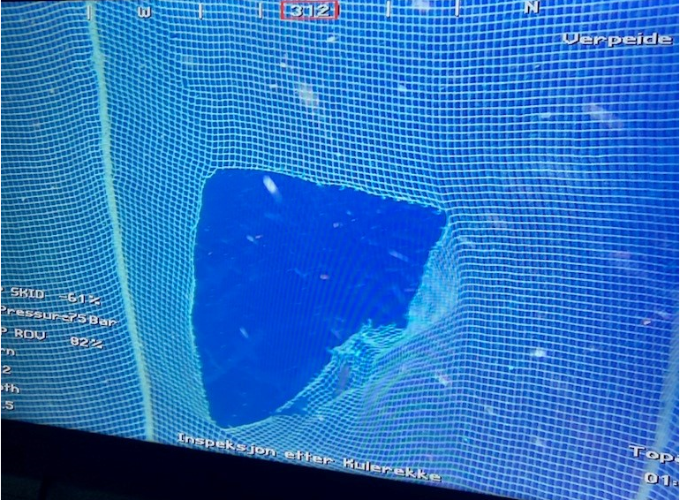
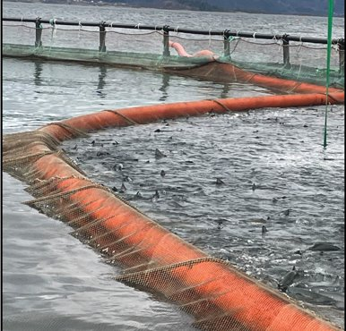
Escape Information Sheet
TAKE ACTION!
Could this incident have happened at your site?
Do you check the centre rope prior to use?
Escape Incident Information Sheet
SITE | DATE | NUMBER OF ESCAPES | CAUSE
Verpeide Norway West | 12.01.2022 | TBC | Probable cause: net got jammed in the cork line while being emptied.
What happened:
Delousing was being carried out with Ro West and the net (spaghetti) was being emptied with a cork line. We suspect that the netting got jammed in the cork line and a hole was torn in the net as a result, or an object got trapped between the cork line and the net. No unknown object was found in the net that could have caused such damage, but it is possible that it may have fallen out of the hole afterwards.
Why did it happen:
Before the net was emptied with the cork line, the centre rope (lifting rope) was raised to lift the net and acclimatize the fish. This rope was worn due to chafing. This rope is important for maintaining control of the bottom of the net and for easing the load/weight on the cork line. A weighted rope was lifted on the back edge of the net to stretch out the bottom and lighten the weight of it. One man was also waiting in a small Steady boat inside the net to try to get a rope placed in the centerpoint of the net as the cork line passed. However, the load/weight on the cork line was too high and it went below the surface of the water, about 0.5 m. At this point, an unknown number of salmon escaped behind the cork line. Apart from the cork line dipping below the surface of the water, no abnormal load on the cork line was noted. Once the net had been emptied of fish and the cork line had been removed, weights were lowered and an ROV inspection was carried out. When the ROV got to the bottom, four salmon were observed escaping through the hole. It was dark, and the light from the ROV attracted the salmon as it approached the hole. During previous inspections at the site, the darkness has proved a challenge, because the fish are attracted to the ROV’s light.
RECOMMENDATIONS
If using spaghetti nets, consider replacing cork lines that use trawl floats with a new type that are air-filled. Tests with the new type in two locations in the region have produced positive feedback.
Centre rope (Lifting line) needs to be checked for strength and quality before use to ensure no chaffing is present.

Slide 2
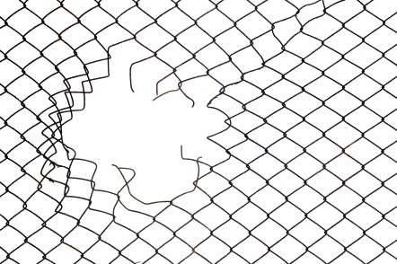
Escape Information Sheet
TAKE ACTION!
Do you ensure that anesthesized fish are monitored during handling?
Do you ensure that equipment and safety measures are properly in place prior to operations involving fish handling?
Escape Incident Information Sheet
SITE | DATE | NUMBER OF ESCAPES | CAUSE
Humphrey Rock Canada West | 08.04.2022 | 1 | Human error
What happened:
The Broughton Aquaculture Transition Initiative (BATI) staff were at Humphrey Rock conducting a sea lice audit. A member of the BATI crew lost a single fish while attempting to return it to the culture pen – post sampling. The fish was placed into a "slide pipe" (used to facilitate a safe re-entry into the cage); unfortunately the fish reacted adversely, managed to bounce out of the pipe, over the catch netting and entered the marine waters next to the cage.
Why did it happen:
After an extensive review by site staff, it was acknowledged that the incident was accidental and directly related to the fishes emergence from anesthesia. Monitoring of fish behavior post sampling, fish handling , catch net / slide pipe placement and vessel movement from waves were additionally identified as key practices to be reviewed prior and during sampling events to prevent escapes caused by human errors.
RECOMMENDATIONS
Ensure that fish behaviour is monitored during handling, especially after being anesthetized.
Ensure that equipment such as safety nets and pipes are of sufficient dimensions and installed to ensure that fish can not fall into the sea.
Ensure that any external personnel handling fish at our sites are properly trained and working in alignment with Mowi’s policies and procedures for escape prevention.

Slide 3
Escape Information Sheet
TAKE ACTION!
Ensure proper procedures are implemented to ensure safe removal of fish from safety net
Escape Incident Information Sheet
SITE | DATE | NUMBER OF ESCAPES | CAUSE
Tveitevåg Norway Breeding | 23.05.2022 | 2 | Missing procedure for safe handling of fish in safety net.
What happened:
During unloading of fish from wellboat Smøla Våg at Tveitevåg brood site an error occurred and the fish were released from the net before being properly positioned. Nine fish fell onto the deck and dock, eventually ending up in the safety net between the dock and wellboat. An operator then went to collect the fish in the safety net, during this operation two fish managed to slip between the net and the boat, ending up in the sea.
Why did it happen:
The cause of the error and incorrect release of fish during unloading of the wellboat remains unknown. There were no procedure for safe removal of fish from safety nets, which could have prevented the fish from escaping.
RECOMMENDATIONS
Change procedures to include safe removal of fish from safety net to be reviewed with all parties involved prior to operation.

Slide 4
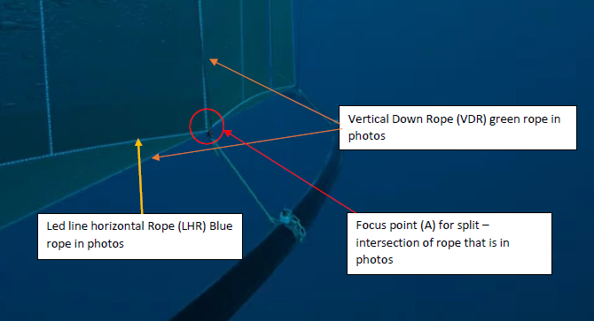
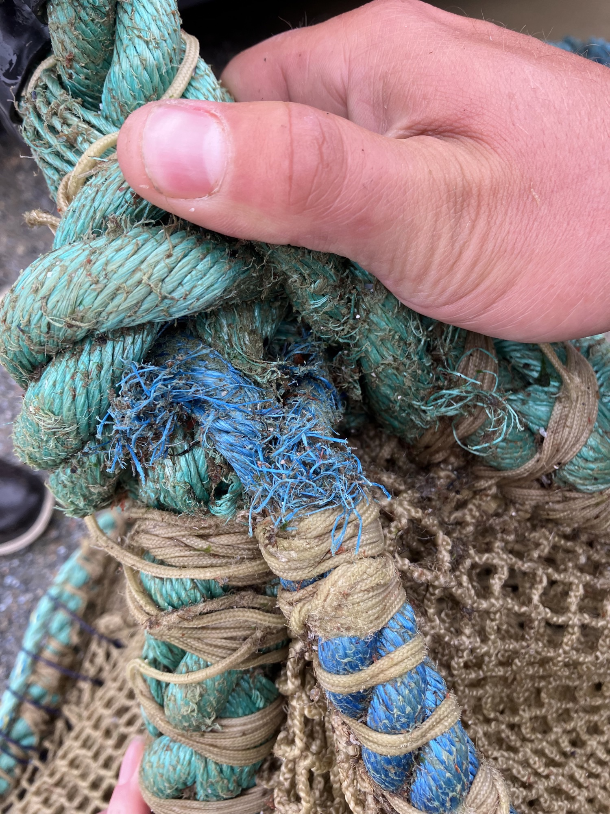
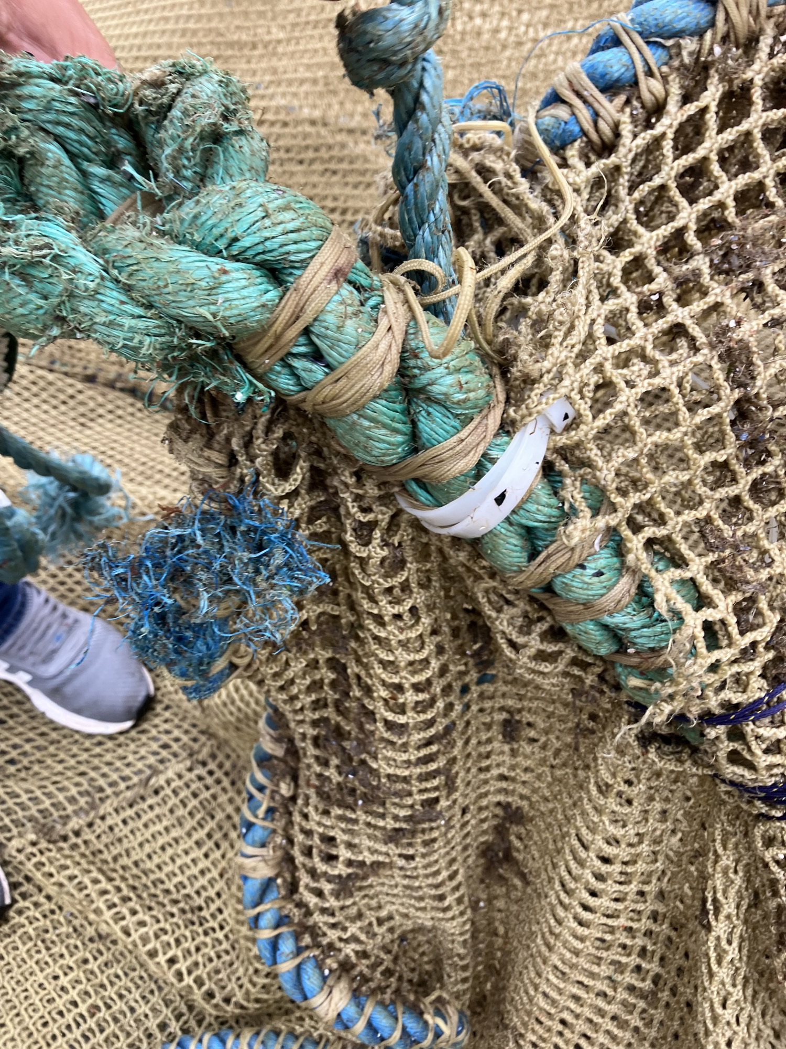
Escape Information Sheet
TAKE ACTION!
Do you record network inspections at your site?​
​
Are there comprehensive procedures for the use and control of ropes during net handling?
Escape Incident Information Sheet
SITE | DATE | NUMBER OF ESCAPES | CAUSE
Outer Grey Horse (Greanem) Scotland | 03.06.2022 | 32 463 | Poor net design combined with human error due to mechanical failure
What happened:
On lifting net for harvest two consecutive winches failed. This resulted in the sinker ring located beneath these winches to remain lowered while the rest of the ring was lifted to 5m. Boats were then used to lift the ring manually. The following day a 4x3 m hole was discovered in the net during net washing. All remaining fish in the pen were moved, and two weeks later all fish were moved from the site as the cause of the net hole was not fully understood.
Why did it happen:
Due to net design the horizonal base line had been rubbing causing the ropes to fray and come apart (see images). This in conjunction with the addition weight placed on the ropes due to the sinker ring being left down caused the rope to snap in two places and split the net along the vertical seam. The supplier (Scale) has improved the design of the ropes after this incident, Mowi Scotland does not have this design in any other site.
RECOMMENDATIONS
All staff to receive formal winch pen training
Update/refresh staff training on winch pens
Regular checks/services of winches
All winch ropes should be lifted simultaneously or in gradual stages to ensure synchronicity, incident could have been prevented if when observing the unbalancing winch push there would have been a moment to stop and re-start in a more gradual way
Net design to be discussed with manufacturer

Slide 5
Escape Information Sheet
TAKE ACTION!
Do you ensure that secondary barriers are in place before the operation starts?
Do you discuss escape risks and the importance of measures to prevent escapes before operation start-up?
Escape Incident Information Sheet
SITE | DATE | NUMBER OF ESCAPES | CAUSE
Kobbavik Norway South | 03.06.2022 | 3 | Missing secondary barrier and unexpected incident
What happened:
During lice treatment on the vessel Frøy Merlin it was decided to sort out cleanerfish for euthanisation. At the end of the operation a lot of cleanerfish were coming through the system at once, overwhelming the equipment capacity so that fish came out the back of the system. These fish ended up on the deck where there was no secondary barrier in place, resulting in two cleanerfish and three salmon ending up in the sea.
Why did it happen:
It was not expected that such a big amount of cleanerfish would be coming through the system at once, the operation was also not prepared to handle fish ending up in other parts of the system. The direct cause to the escape was that the delousing vessel did not have any secondary barrier in place to prevent fish from falling into the sea.
RECOMMENDATIONS
Information on the incident has been shared across the region
The system at Frøy Merlin has been improved to secure that fish can not enter through the back
All delousing vessels have installed sufficient secondary barriers
A new check point has been introduced to be reviewed in the preparation meeting prior to operation start, to ensure all parties involved have a common understanding of the importance and meaning of escape prevention.

Slide 6
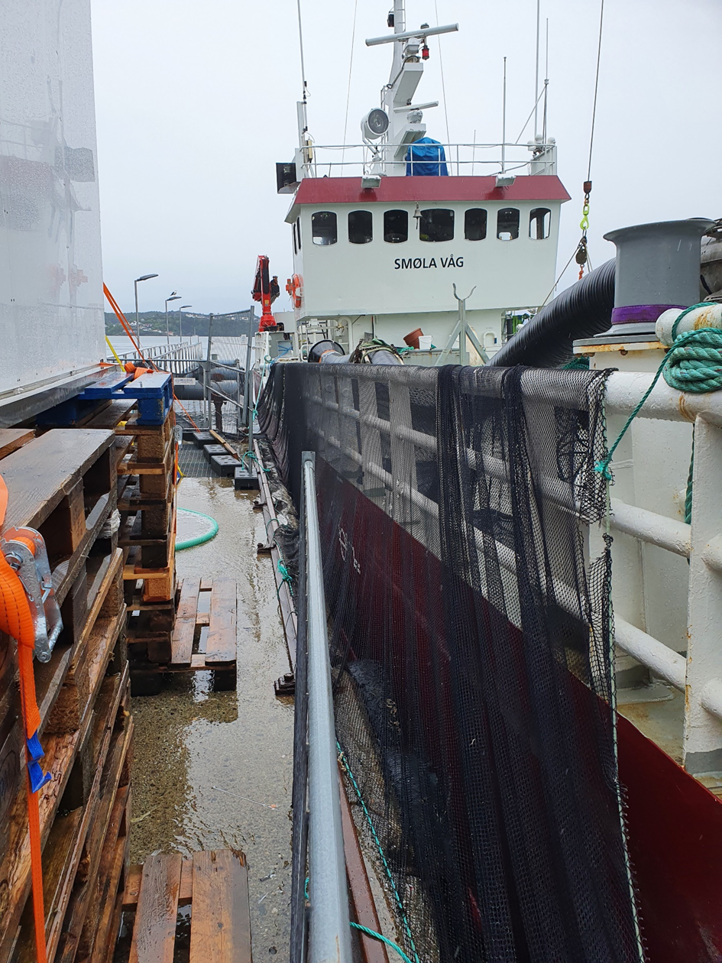
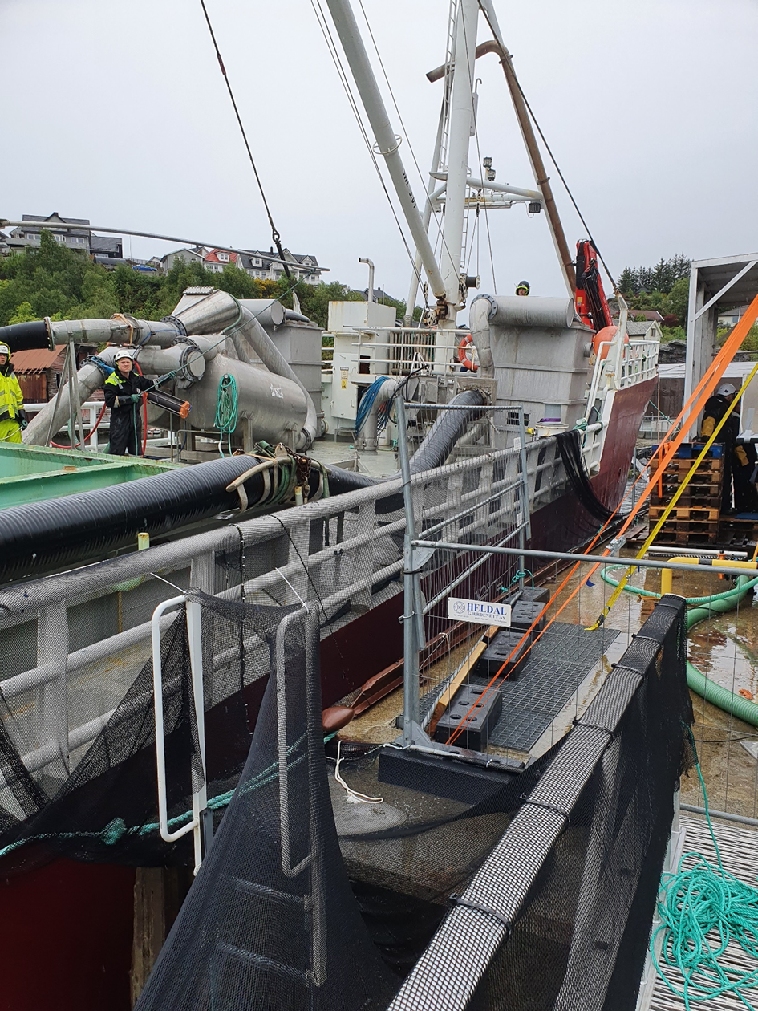
Escape Information Sheet
TAKE ACTION!
Could you have suffered this incident?
Do you record network inspections at your site?
Are there comprehensive procedures for the use and control of ropes during net handling?
Escape Incident Information Sheet
SITE | DATE | NUMBER OF ESCAPES | CAUSE
Colonsay Scotland | 16.06.2022 | 17 500 | Seal/net tension
What happened:
The cage net was checked 24hrs prior to harvest , net was shallowed and harvest completed , cage net and Froya ring lowered , seal noticed in cage the next day , ROV put into cage and noted a hole on base at the double mesh on the bottom of a vertical , but also that the net at that point was highly tensioned , PG net was deployed to cover the hole till divers could rectify.
Why did it happen:
It would appear that a seal had made an initial breach in the net post harvest operation, but also that a couple of ties had come off the net and Froya ring on either side of the hole causing the Froya ring to drop and creating tension on the point where the net was connected and the net tore further.
RECOMMENDATIONS
Nets and Froya ring ties should be checked prior to and post lifting event to ensure that the net integrity has not been breached and all net ties are secured

Slide 7
Escape Information Sheet
TAKE ACTION!
Do you ensure procedures are followed to prevent escape risk when handling live fish at the site?
Do you ensure that equipment is used correctly and of sufficient dimension for
Escape Incident Information Sheet
Site | Date | Number of Escapes | Cause
Storvika V Norway North | 19.7.2022 | 1 | Procedure not followed
What Happened?
The incident took place during sea lice counting. The work boat was docked at the pen and safety net installed according to procedure prior to operation start-up. As the operation started the position of the boat shifted, resulting in the re-positioning of the safety net in relation to the pen and the crowded fish. Five fish were collected by net and lifted across the hand rail, now outside the safety net, to be transferred to personnel on the boat deck. At this moment one fish fell out of the net and into the sea below.
Why did it happen?
Procedure was not followed according to the point stating that the net containing the fish is to be held and moved along the middle of the safety net during transfer of fish. Conversations with the staff revealed that the team involved in the operation had been working on delousing operations in the previous days and were tired after working night shifts. Tiredness and following lack of concentration could have contributed to why the necessary correction of the safety net placement was not conducted after the boat shifted position . Both fish size (above two kg) and number of fish in the net could also have been contributing factors to the escape. There were three temporary employees involved in the operation, all had received the necessary training and had sufficient experience to take part in the operation.
RECOMMENDATIONS
Follow procedures, do not take unnecessary risks.
Correct position of safety net/boat when necessary
When transfering fish above 2 kg, transfer only a few individuals at the time
Use net that is dimensioned for the fish size
Consider waiting/delaying the operation if staff is tired

Slide 8
Escape Information Sheet
TAKE ACTION!
Do you ensure external well boats check and confirm that system set-up is correct prior to operation start-up?
Escape Incident Information Sheet
SITE | DATE | NUMBER OF ESCAPES | CAUSE
Korsholman Norway Mid | 01.08.2022 | TBC | Technical/human error on wellboat
What happened:
The incident happened during sea lice treatment with hydrolicer. As the operation started and fish were loaded onto the treatment vessel an error occurred in the system, resulting in reduced volume in one of the wells.
Why did it happen:
As it became critical for the fish welfare, fresh seawater was pumped into the system to improve the situation. The grates in the system were covered, thereby causing the pressure to rise, resulting in the fish and water the being pushed back out through the hydrolicer system and into the sea. There were barriers in place along the rails of the boat but as the system opening was located above the rails this did not prevent the fish from ending up in sea.
RECOMMENDATIONS
Ensure external well boat companies have routines in place to ensure system is set up and positioned correctly before the operation starts, this to secure good fish welfare and prevent escapes during treatment
Ensure information and requirements are shared with other well boat companies

