Slide 1
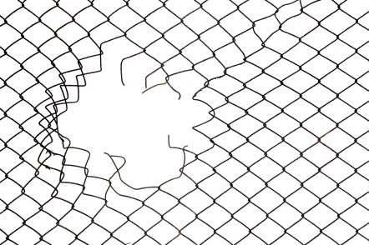
Escape Incident INFO SHEET
BU
Norway
Mid
Site’s name
Nørholmen
Incident’s date
2017
# escapees
5
Cause
Human error – missed visual inspection of empty net
Contact Person
Eigil Tofte
Why did it happen?
Recommendations
"Empty" net not checked for the presence of fish before being removed.
Improve communication between those involved in the operation so a visual check of fish jumping to the empty side of the net is communicated.
Always run a visual inspection of the nets before these are removed from production.
What happened?
In connection to a sea lice treatment (Freshwater in well boat) fish were crowded using a float line (“kulerekke”). Fish probably jump to the empty side of the net or remained in the bottom of the net while this was being lifted up. After pumping out the fish the net was put down without checking if there were fish left. Some days after when net was before lifted and removed out from production some fish still left on the net escaped.
Authorities were contacted. Gill nets were deployed and 5 fish were recaptured.
Take ACTION: Could this incident have happen to you? Do you always run visual checks on “empty” nets before these are removed from production?
More Info: Incident report & Evaluation report
https://marineharvest1.sharepoint.com/sites/incidents/_layouts/15/FormServer.aspx?XmlLocation=/sites/incidents/Crisis/MH%20Norway%20Mid/2017-10-31___Escapes___MHNorway%20Mid.xml&ClientInstalled=false&DefaultItemOpen=1&Source=https%3A%2F%2Fmarineharvest1%2Esharepoint%2Ecom%2Fsites%2Fincidents%2FCrisis%2FForms%2FAllItems%2Easpx%3FRootFolder%3D%252Fsites%252Fincidents%252FCrisis%252FMH%2520Norway%2520Mid%26FolderCTID%3D0x012000DEFD63F4261E4E4B817E2E830B14551B%26View%3D%257BA5802359%252D9030%252D4726%252DBD11%252D5D59F3A16E3C%257D&CT=1511432035529&OR=DocLibClassicUI

Slide 2
Escape Incident INFO SHEET
BU
Scotland
Site’s name
Envasion Bay
Incident’s date
01 – 11 - 2017
# escapees
6
Cause
Human error – net caught in propeller
Contact Person
Steven Jamieson
Why did it happen?
Recommendations
Slack net was drawn into the propeller as the boat was attempting to moor on the treatment cage edge
Run a briefing with the boat crew prior to any operation to clarify all the steps in the procedure as well as roles and responsibilities;
Use a simplified procedure/checklist to help you covering all the key points that need to be addressed with the boat crew
Both site personnel from MH who will be involved in the operation as well as members of the crew should sign the checklist under point 2.
What happened?
Boat came alongside pen 1 at sea site Envasion Bay whilst net was being listed for a thermolicer treatment. Net was sucked into propeller and resulted in tear 4m long * 100 cm wide. 6 fish (3,2 kg) seen to escape. Lack of communication between skipper of the boat and the assistant site manager resulted in skipper moving the boat while net was being lifted. Divers were called in and closed the hole within 2 h after the incident. Site was using environmental nets so it was possible to continue with the lice treatment as an additional net was already in place. Counting of fish after thermolicer treatment revealed a positive count. Authorities accepted the total number of fish escaping as 6. Damaged net was sent for repair.
Take ACTION: Could this incident have happen to you? Have you implemented checklists before operations are done that involve third-parties? Do you make sure checklists are signed by both MH employees and the crew on the boat ?
More Info: Incident report & Evaluation report https://marineharvest1.sharepoint.com/sites/incidents/_layouts/15/FormServer.aspx?XmlLocation=/sites/incidents/Crisis/MH%20Scotland/2017-11-01___Escape___MHScotland.xml&ClientInstalled=false&DefaultItemOpen=1&Source=https%3A%2F%2Fmarineharvest1%2Esharepoint%2Ecom%2Fsites%2Fincidents%2FCrisis%2FForms%2FAllItems%2Easpx%3FRootFolder%3D%252Fsites%252Fincidents%252FCrisis%252FMH%2520Scotland%26FolderCTID%3D0x012000DEFD63F4261E4E4B817E2E830B14551B%26View%3D%257BA5802359%252D9030%252D4726%252DBD11%252D5D59F3A16E3C%257D&CT=1511268478808&OR=DocLibClassicUI

Slide 3
Escape Incident INFO SHEET
BU
Scotland
Site’s name
Envasion Bay
Incident’s date
2017
# escapees
6
Cause
Human error – net caught in propeller
Contact Person
Steven Jamieson
If the vessel arrives on site when personnel are absent/gone home a pre-planned mooring position will have been agreed with the Site Manager/Appointee.
The Site Manager/Appointee will meet with the skipper/crew of the vessel on the day of treatment and discuss the plan for the period they are working on site .
Site Manager/Appointee will agree a working vhf channel to keep communication concise , this should be conveyed to all working personnel.
The net should be prepared and taut, only when this has been carried out should the boat be called to come along side.
Weather conditions , tidal currents etc should be considered and discussed in pre amble.
Procedure developed by area manager after incident:

Slide 4
Escape Incident INFO SHEET
BU
Scotland
Site’s name
Loch Alsh
Incident’s date
2017
# escapees
unknown
Cause
Human error – pipe discharging to sea during thermolicing
Contact Person
Hugh Mackinnon
Why did it happen?
Recommendations
During thermolicer treatment, discharge pipe was not properly secured ending up in the sea.
Strengthen instructions/training prior to the execution of thermolicing so that procedures regarding securing discharge pipes are followed;
Verify that video cameras used in the control room are functioning well and well positioned to verify suction and discharge points.
What happened?
At Loch Alsh, fish were being treated against sea lice at the time of incident (using thermolicer). During treatment fish were being pumped from one pen to another. Discharge pipe was not properly secured and ended up in the sea resulting in fish escaping. Video cameras used in the control room to check both suction and discharge points did not work properly. Average weight of escaped fish was 4.5 Kg. Unknown number of fish escaped (waiting for harvest counting).
Take ACTION: Could this incident have happen to you? Have you spend enough time going through the procedure with all involved prior to the start of delousing? Do you verify your video cameras in the control room to make sure they are working and well positioned?
More Info: Incident report & Evaluation report
https://marineharvest1.sharepoint.com/sites/incidents/_layouts/15/FormServer.aspx?XmlLocation=/sites/incidents/Crisis/MH%20Scotland/2017-11-23___escape___MHScotland.xml

Slide 5
Escape Incident INFO SHEET
BU
Norway North
Site’s name
Istervika
Incident’s date
04 – 11 - 2017
# escapees
16
Cause
unknown
Contact Person
Øystein Flatmo
Why did it happen?
Recommendations
Unclear
What happened?
Not applicable as the cause of the escape remains unclear
Five holes were discovered when net was being pulled up for harvesting. Holes were found from -9.5 m to -15m depth. Holes varied in size being the largest the size of a football. Fish were on average 5.5. Kg. 16 fish were recaptured. Counting after harvesting revealed a positive count so number of escapes accepted by the authorities was 16.
The following operations where the net was handled took place some weeks before harvesting: delicing (17th Oct) and net washing (23rd/24th Oct). In both occasions net was checked and no holes were reported.
Take ACTION: Could this incident have happen to you? Do you receive reports from divers after checking the nets which include visual confirmation, such as pictures/videos?
More Info: Incident report & Evaluation report

Slide 6
Escape Incident INFO SHEET
BU
Scotland
Site’s name
East Loch Tarbert
Incident’s date
04/02/2018
# escapees
12
Cause
Net handling
(aeration sledge/bath treatment)
Contact Person
Scott Cameron
Why did it happen?
Recommendations
Hole created by an aeration sledge deployed before a bath treatment against sea lice.
Keep aeration sledge as tight as possible to the vessel deploying it as well as keeping it tight to the vessel pulling across. This is to try to keep the sledge off the base of the net.
Have someone on the pen with the treatment at all time so if something is not right it will be spotted sooner rather than later
What happened?
Net was fully raised, aeration sledge was deployed [before tarp, bath sea lice treatment] and pulled across the pen by the capstan of another vessel. Because of the weight of this sledge it is quite difficult to keep off the base of the net. Although we are not 100% certain the sledge catching on the net as it was pulled across is the most likely scenario for the tear. 12 fish were observed between the net and the tarp. Net was dropped and temporary repair made. Close observation continued, no signs of any other escaped fish noted.
Take ACTION: Could this incident have happen to you? Do you make sure aeration sledge using during bath treatments is kept as tight as possible so it doe not sink to the bottom?
More Info: 1. Incident Report, 2. Evaluation report:

Slide 7
Escape Incident INFO SHEET
BU
Norway
North
Site’s name
Geitryggen
Incident’s date
05/02/2018
# escapees
54,000
Cause
Net handling
(prior to delousing)
Contact Person
Magnus Dille
Why did it happen?
Recommendations
Net hole created by ropes holding a bottom plastic ring which broke while net was being pulled up before a delousing treatment.
Do not use plastic rings in the bottom of the nets
Use ROVs or divers to check net integrity from the outside of the net before net handling
What happened?
54,000 fish at an average weight of 2kg, escaped from Geitryggen sea site, before a delousing treatment. Net was being pulled up when unusual tension was noted on the ropes. Divers were called and saw a 11.5 meters hole starting in the bottom of the net and extending to the side. Recapturing efforts resulted in 1200 fish being recaptured.
Take ACTION: Could this incident have happen to you? Do you use plastic rings in the bottom of your nets? Do you always run a net inspection with divers/ROVs to check net integrity from the outside of the net?
More Info: 1. Incident Report, 2. Evaluation report: https://marineharvest1.sharepoint.com/sites/incidents/_layouts/15/formserver.aspx?XsnLocation=/sites/incidents/FormServerTemplate/CEV_0502.xsn&OpenIn=Browser

Slide 8
Escape Incident INFO SHEET
BU
Norway
North
Site’s name
Austvika
Incident’s date
14/02/2018
# escapees
52,764
Cause
Net washing
(most likely cause)
Contact Person
Roger Pettersen
Why did it happen?
Recommendations
Most likely, hole created during a net cleaning event.
Make sure cleaning equipment is checked by Marine Harvest employees together with employees from cleaning company. Have both parties signing a checklist prior to start a cleaning event.
Make sure all net cleaning companies make video recording of the cleaning event and provide you the video files at the end of the operation.
What happened?
A hole was discovered by Frøy Akvaservice while washing net 1 (nylon) at site Austvika. After the hole was discovered, net was lifted up and the hole was closed. Net was changed one week after. Counting of fish revealed 52 764 have escaped of 780g. Cause of incident is not completely clear, but most likely a previous washing event on the 13th of Dec 2017 has caused the hole, despite the net has been inspected after the previous washing. Fish probably escaped periodically between December 13 2017 and February 14 2018 since not discovered when feeding.
Take ACTION: Could this incident have happen to you? Before starting a cleaning event, do you use checklists signed by you and the external service companies? Do you request your service suppliers video recording of the cleaning operations?
More Info: 1. Incident Report, 2. Evaluation report: https://marineharvest1.sharepoint.com/sites/incidents/_layouts/15/formserver.aspx?XsnLocation=/sites/incidents/FormServerTemplate/CEV_0502.xsn&OpenIn=Browser

Slide 9
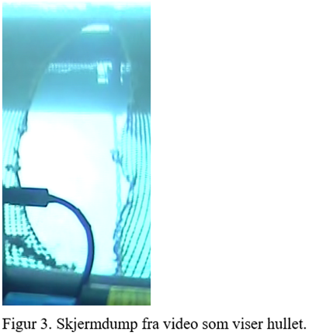
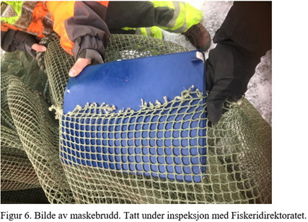
Escape Incident INFO SHEET
BU
Norway
North
Site’s name
Austvika
Incident’s date
14/02/2018
# escapees
52,764
Cause
Net washing
(most likely cause)
Contact Person
Roger Pettersen

