Slide 1


Slide 2



Your single point of contact for IT
MOWI IT Service Desk
(staff primarily based in the Bergen office, Norway)
E-mail: ITHelp@mowi.com telephone: see tables below
External Suppliers
Marel, CodeIT, Microsoft, Expereo, Acer, Orange Business Services, etc.,
Other Cognizant Departments
Access Management, Messaging,
WINTEL, SIO, EUC, etc.,
Norway: +47 2156 2020
Faroe Islands: +47 2156 2020
Scotland: +44 1397 715 200
Ireland: +35 3275 7400
UK: 0800 635 1260
Local IT Departments
Scotland, Ireland, Norway, Poland, USA, Canada, Asia, Chile, etc.,
Canada: 1250 850 3276
US: 1877 408 9578
Belgium: +32 5045 8369
Netherlands: 8000 229 979
France: +33 391 180 300

Slide 3

IT Support
All IT related requests (whether for
support, general information or for
the supply of IT equipment) should
initially be logged with the MOWI
Helpdesk either by sending an
e-mail to ITHelp@mowi.com or by
phoning your regional number.
Raising tickets with the helpdesk
will ensure that your request is dealt
with by the correct team as quickly
as possible.

Slide 4
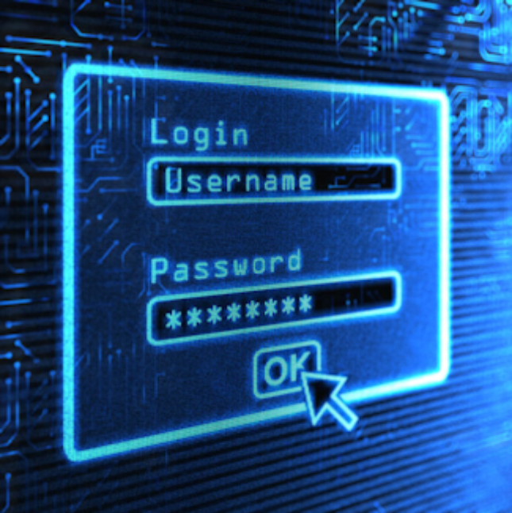
Passwords
Passwords expire after one year.
They should be a minimum of 12
characters long and should be pass
phrases that you can remember but
shouldn't be easy for others to guess
(e.g. "Formula 1 McLaren").
Never leave passwords anywhere, and
do not share passwords.
Password sharing and / or
mis-management could lead to
disciplinary action or dismissal.

Slide 5
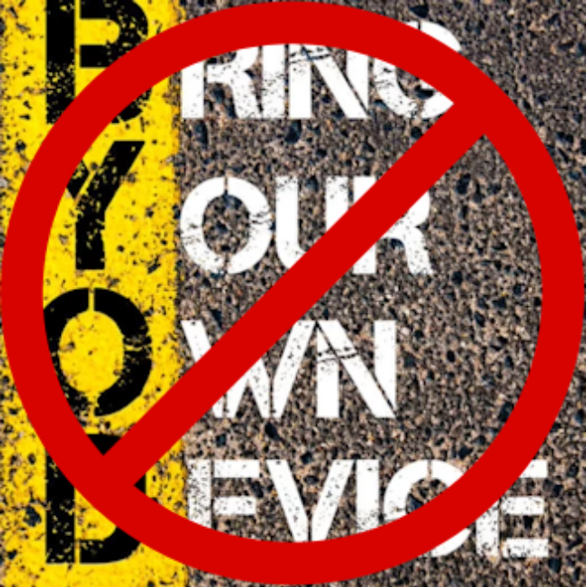
Personal devices
Personally owned computers (or
other IT equipment) must not
under ANY circumstances be
connected to the MOWI corporate
networks.

Slide 6
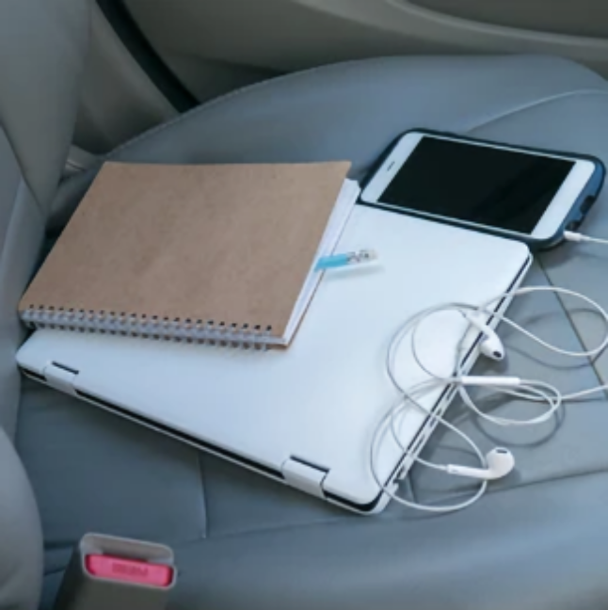
Don’t leave devices
In vehicles
Laptops, phones and tablets are easy
targets for thieves.
When the weather is very cold, device
screens can freeze and break. The cold
also shortens battery life.
In very hot weather, plastics can warp
and sensitive internal components can
melt.

Slide 7
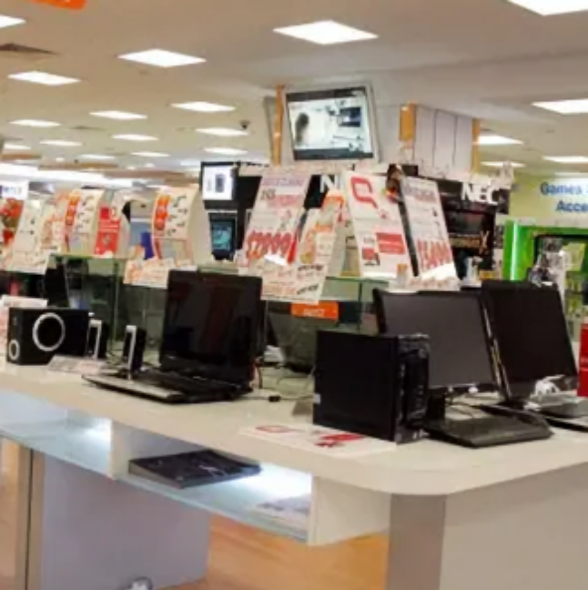
Purchasing
With the exception of small consumable
items, all IT equipment (computers,
printers, etc.) must be procured by the
IT department, and only after you have
raised a ticket with the IT Helpdesk.
MOWI IT does not supply laptop bags or
mobile phone cases. These should be
ordered (with your line managers
approval) from approved suppliers, or
paid for personally and claimed on
expenses.

Slide 8
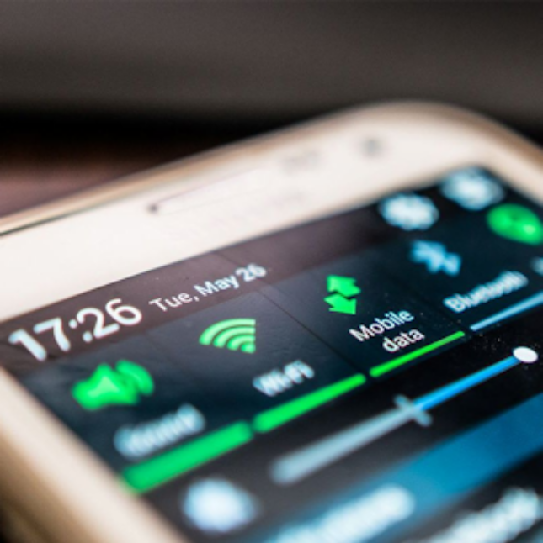
Mobile devices
As part of your job, you may be issued
with a mobile phone or tablet.
MOWI have a shared pool of data across
all devices. As such, no streaming of
any kind of media should be performed
using the mobile data network.
Please use Wi-Fi whenever and
wherever possible.

Slide 9


Lock it when you
leave it!
If you need to leave your computer,
mobile phone or tablet, no matter
how briefly, then ensure that you
log out or lock it first.
Forgetting to lock or log out poses a
security risk and leaves YOUR account
open to abuse!

Slide 10
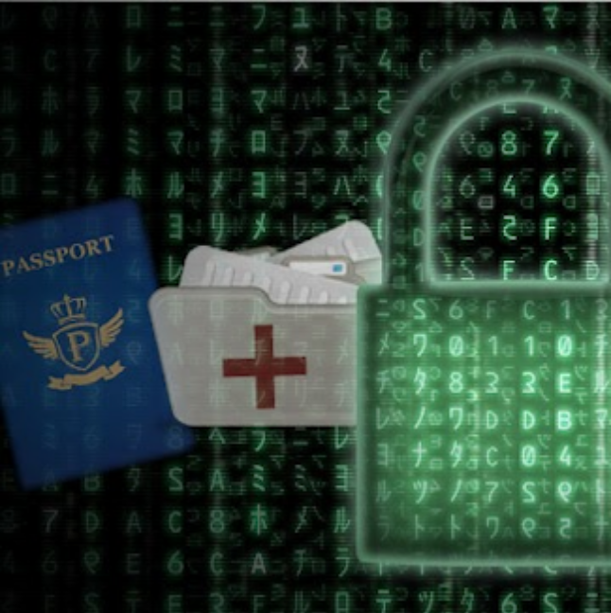
Sensitive data
Depending on your role within MOWI,
you may have access to sensitive or
confidential company or personal
information.
You may be required to sign
confidentiality agreements.

Slide 11
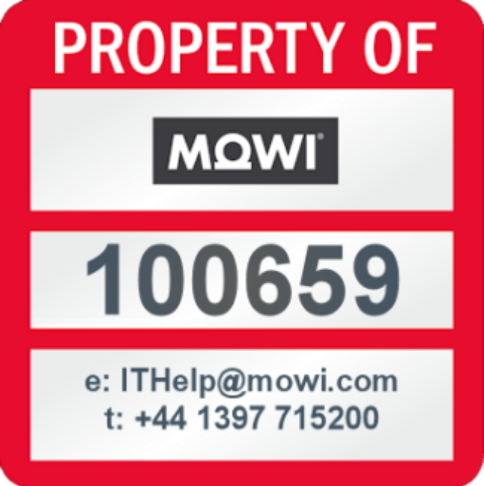
Ownership
All devices and equipment issued
remain the property of MOWI and
must be returned upon termination
of contract or upon the request
of the IT department.

