Slide 1
Contractor Induction
MH-HST-014-13 Contractor Induction
May 2022

Slide 2
Welcome to Mowi Consumer Products
You are about to complete our contractor induction training course. We understand that you may have encountered induction many times before, however it is important that you take the time to complete our induction and complete the short assessment prior to starting work.
All contractors will complete this course as part of their induction process.
Successful completion of the course will be measured by means of assessment and achieving the minimum pass marks.
Records of all training completed will be held on file. Induction will be refreshed on an annual basis for all contractors as a minimum. There may be a requirement to update more often subject to significant change to plant, personnel or customer requirements.

Slide 3




Access and Egress:
All visitors / contractors must report to Reception or Permit Office upon arrival and sign the visitors’ book.
Once the induction is completed contractors can park on site in Hall B parking area and use the Contractor Entrance to access the Facilities/Permit Office.
All contractors must go through the induction process & receive a Permit to Work (PTW) prior to commencing any task.
Parking in the yard is not permitted. Tools can be dropped off prior to commencing work. All vehicles must be moved to the designated carparking space.
The site speed limit for all vehicle s is 10mph. The site speed limit must be observed.
Do not park in visitors or reserved spaces. Accessible places can only be utilised if you are a current blue badge holder.

Slide 4








General Site Procedures:
Mobile Phones are prohibited with production area unless prior consent is obtained from your host.
The use of cameras or video equipment is not permitted in all internal and external areas unless prior consent is obtained from your host
Smoking is strictly prohibited within any building. Smoking is permitted only within the designated smoking area. Smoking materials should not be taken into Production areas. This includes E-Cigs.
No Eating or Drinking in Production or external areas.
The food / drink must only be consumed in the canteen facilites
The use of naked flames is prohibited matches and lighters must not be taken into production areas. Hot work is strictly controlled under PTW.
All jewelry including watches & religious jewelry must be removed prior to entering Production, with the exception of a plain wedding band.
Chewing gum is prohibited
anywhere on site
This is a nut free zone.
Do not bring nuts or nut based products onto site

Slide 5




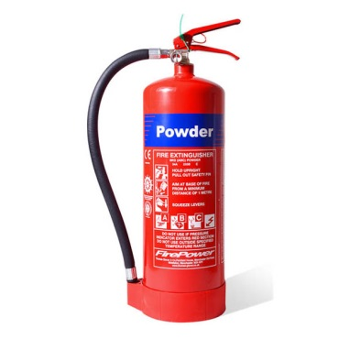
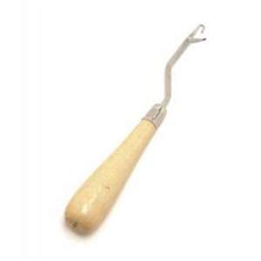
General Site Procedures:
CCTV in operation. 24hour recording in place, including thermal imaging cameras in Reception and the employee entrance.
Hand must be washed prior to entering any Production area
Where aerosols are required as part of the task, ensure they are removed from site on completion of the works.
Spitting is strictly prohibited everywhere on site
Wooden handled tools are not permitted in the production area.
Fire fighting equipment must not be used for any other purpose than fighting fires.
For example; they must not be used as door stops.
Snap off blades and stanley knives are not permitted on site. Safety knives must be used.
Food safe knives are available on site, ask your site contact.

Slide 6

General Site Procedures:
All spills must be reported.
Stop
Isolate
Contain
Report
Clean Up & Segregate waste
Investigate
All glass and hard plastic breakages must be reported.
Stop
Contain
Report to your Host.
If your task will result in the generation of swarf (e.g. drilling, grinding), the activity MUST be food risk assessed before it begins. Your host will guide you through the process.
Spill kits are available for use throughout the site.
Yellow wheeled bin = Chemical kit
Blue wheeled bin = oil kit
If used, please report to your host

Slide 7
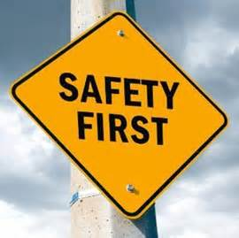
Starting Work:
The site can be accessed by road with additional contractor parking at Hall B .
The site speed limit and other traffic control measures in place must be observed.
Upon arrival at the site, report to Reception or Permit Office and sign in. Your host / contact will collect you from Reception or issue you a Permit to work.
Equipment / Tools etc can be dropped off in the yard. All contractor vehicles must be parked in the designated carpark space, unless otherwise agreed by your host.
Risk Assessment and Method Statements (RAMS) documents must be submitted to your host prior to commencing work.
A permit to work will be issued by an authorised person before any work is carried out.
Copies of appropriate licenses, training certificates etc. may also be requested if required.

Slide 8
Permit to Work:
All Contractors must have a valid permit to work before carrying out any task.
A permit to work will be issued by an authorised person for a defined amount of time. Only work covered by the permit may be carried out. When new work is identified during a task the permit must be amended and re-issued before continuation of work.
Risk assessments and method statements along with any other relevant information* must be submitted for review prior to work commencing.
* Other information may include lifting plans, COSHH assessments, training certificates, Licenses, sampling results if deemed appropriate for the task. Please note this list is not exhaustive.

Slide 9
Finishing Work:
All debris / waste must be removed from site and disposed of by the contractor (consideration for local waste legislation must be given)
Work areas are to be left clean tidy and safe for our staff to use or our hygiene team to begin deep cleaning.
Any barriers etc must be removed.
The Permit to Work must be signed off prior to leaving site by the contractor and the host.
Sign out at reception or Permit Office and leave site.

Slide 10
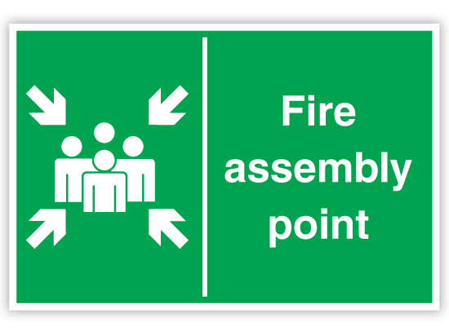
Emergency Procedures - Fire:
Fire: - The Fire alarm is tested every Wednesday at 2pm
The alarm is a two-tone siren.
Upon hearing the fire alarm:
Stop work and leave the building by the nearest available exit.
Do not stop to collect personal belongings or to remove Protective clothing
Report to the assembly point where the fire wardens will account for you.
Upon discovering a fire:
Raise the alarm by activating the nearest break glass call point
Evacuate the building in a safe manner
Do not stop to collect personal belongings or to remove Protective clothing
Report to assembly point 5.
DO NOT LEAVE THE SITE OR RETURN INTO THE BUILDING WITHOUT PERMISSION FROM THE SITE INCIDENT CONTROLLER
5

Slide 11

Fire Safety – Assembly Points:
Once at your assembly point your fire warden will be wearing orange hi vis vest.
The fire warden is responsible for the role call.
Please make sure you are accounted for.
5
Notes:
Do you know your assembly point number?

Slide 12
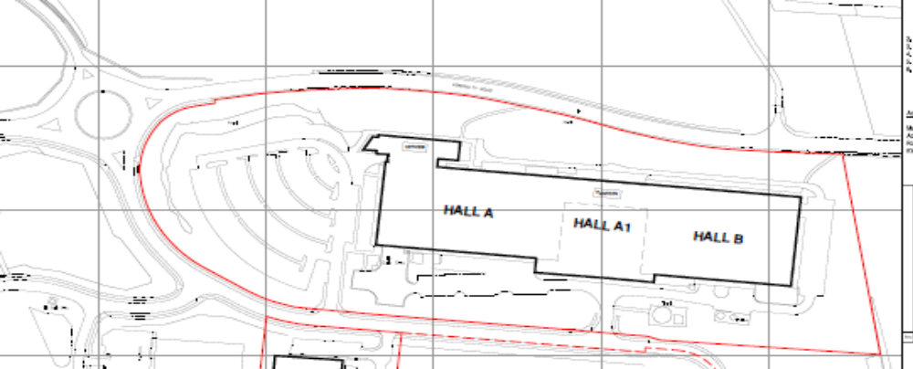
Emergency Procedures – Fire :
Fire Assembly Point
9
Fire Assembly Point
5
Fire Assembly Point
1
Fire Assembly Point
10
Notes:
Ensure you tell everyone to be aware of there nearest fire exit at all time. This is more than likely not the way you entered the building.

Slide 13


Emergency Procedures - Accident / Incidents / Near miss:
All accidents, Incidents and near miss events must be reported to prevent recurrence including damage and spills.
Accident – An unplanned event resulting in injury or harm
Incident – An unplanned event that results in damage or loss
Near Miss – An event that had the potential to cause injury, harm, damage or loss
All of the above must be reported to your Site Contact. Health and Safety is everyone's responsibility.
First Aid provisions should be made by the contractor however where this is not possible Mowi will support. If first aid is required please request assistance from any member of staff who will contact a first aider on your behalf.
First Aiders can be identified in Production Areas by the green hairnets and/or armbands. Photos of First Aiders are also published on various noticeboards throughout the site.
Only blue metal detectable plasters are issued on site. There is a Plaster Tracking Procedure which must be followed. The First Aider issuing the plaster will give you instructions to follow if you need a blue plaster.

Slide 14




Personal Protective Equipment (PPE):
PPE is dependant on the task being performed and areas you are working in. Your site host is responsible for providing instruction on the area requirements.
Requirements within the factory: Hair net, beard snood (if appropriate), overall and safety footwear. The colour of overcoat is dependant on the area and your function. Hairnets are colour code with visitor/contractor wearing pink.
External yard : high vis jacket and safety footwear.
All PPE Should be kept in good condition and any defects reported immediately so replacement can be arranged.
Do not use damaged or faulty PPE.
Failure to wear appropriate PPE may result in contactors being asked to leave site.
Hearing protection must be worn in RTC, Refrigeration Plant Rooms, Primary, High Care, and RTC Final Pack.

Slide 15
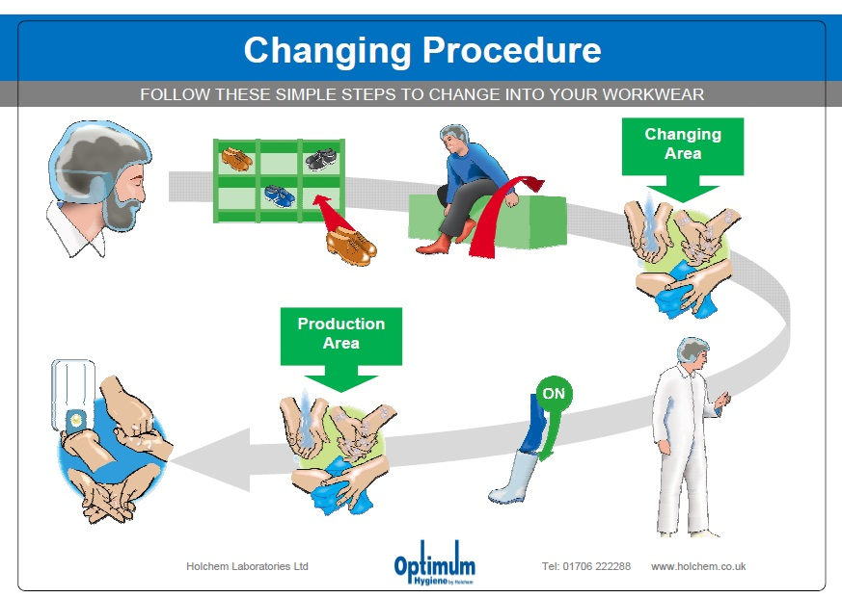
Personal Protective Equipment (PPE):
PPE must be worn in the correct manner.
The steps below detail the order PPE should be worn on entry into
the Factory. All PPE is available in the Hygiene Lock.
Hairnet
Beard Snood (if applicable)
Footwear
Wash hands
White coat / overall (engineering coats are available)
The steps below detail the order in which PPE should be removed on exit from the Factory. Once in the Hygiene lock
Remove white coat and place on a peg or in the laundry cage
Remove footwear and place on the rack.
Remove hairnets and beard snood and place them all in the bin provided.
Exit the area

Slide 16

Machinery / Tools / Equipment:
All machinery / equipment must be fit for purpose and have appropriate guarding.
All portable appliances must have been tested prior to bringing the equipment on site.
Machine guards are fitted to protect the Operator, and must be in place at all times when the machine is running. Prior to guards being removed for machine cleaning or maintenance the must be fully isolated using the lock off and isolation procedure.
Safety systems must not be by-passed at any time.
Refuelling of any equipment on site should be avoided. Where refuelling on site cannot
be avoided it must be carried out in an area away from any surface drains.
All tools must be clean and free from contamination before being taken into the
Production Area
All tools brought on to site must be removed from site.

Slide 17
Ammonia:
Ammonia is a colourless gas, stored and used in refrigeration plant. This is external to the food production area.
Exposure to vapours can cause burns to outer tissue of eyes, nose, throat and lungs.
Prolonged exposure can cause suffocation
Emergency Response: If alarms sound
Your host or Security will notify you if action is required.
You will be directed to shelter in door in the staff canteen.
Do not exit the building until informed it is safe to do so.
If an evacuation is required, you will be told how to proceed.
No smoking is be permitted during an evacuation.

Slide 18
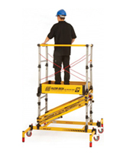
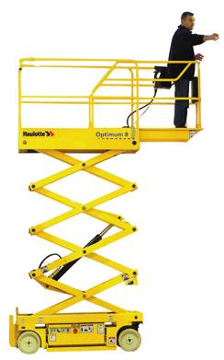
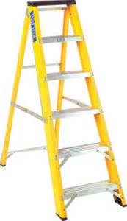
Ladders:
Ladder work should be for short duration tasks.
Work over 3m or that is expected to take more than 1 hour alternative access equipment should be used. The use of MEWPs must be only be carried out by trained personnel. Scaffolding must be erected and certificated by a competent person.
All ladders must be inspected & records kept prior to use to ensure they are fit for purpose, in a good state of repair and clean/hygienic so there is no risk to food safety. Scissor lifts should be white wheels only.

Slide 19
Food safety:
Food safety is critical to our business.
High standards of personal hygiene are expected.
Handwashing and changing procedures must be followed relevant to the area you will be working
Health questionnaire must be completed prior to entering the Production Environment.
Contractors found not following the procedures will be removed from site.

Slide 20
Allergens:
The symptoms of a food allergy almost always develop a few seconds or minutes after eating the food.
Some people may develop a severe allergic reaction (anaphylaxis), which can be life-threatening.
The most common type of allergic reaction to food is known as an IgE-mediated food allergy.
Symptoms include:
  tingling or itching in the mouth
  a raised, itchy red rash (urticaria) – in some cases, the skin can turn red and itchy, but without a raised rash
  swelling of the face, mouth (angioedema) or other areas of the body
  difficulty swallowing
  wheezing or shortness of breath
  feeling dizzy and lightheaded
  feeling sick (nausea) or vomiting
  abdominal pain or diarrhoea
  hay fever-like symptoms, such as sneezing or itchy eyes (allergic conjunctivitis)

Slide 21

Technical, Quality and Food Safety:
Listeria – Food Poisoning Bacteria
Found : Water, soil, environment
Can then reach : Fish, Floors, Food Contact surfaces & Drains
Don’t let it survive in Rosyth
Floor or drain contact with hands/gloves is not permitted. This is an essential control in minimising Listeria contamination and instances of food poisoning
If floor contact occurs – hands must be washed / gloves must be changed immediately.
No. 1 Food Safety risk

Slide 22
Environment:
Mowi needs the natural environment to produce salmon. It is vital that we play our part in protecting the environment from pollution through emissions to air, land or sea.
For example:
Chemicals or surplus materials should not be disposed off through the drainage system.
Use of energy efficient equipment
Consider the environmental impact of any contractor activity.
Recycling of waste – segregation at source and remove from site
Your help supports this process and the business to reduce its environmental burden.

Slide 23

COVID 19 – control measures
Masks are no longer required on site.
Please be aware we still have some restrictions in place.
You will be informed of any upon site arrival.

Slide 24
Any questions please contact Kirstie.graham@mowi.com

