Slide 1

Ref: GWI043 Approved by: Diane Yarwood Version no: 2 Date: 31/08/2021
PRODUCT SAFETY
HIGH/LOW RISK SEGREGATION:
Barrier Control
Protection of our Ready to Eat Products

Slide 2

DEFINITIONS

Slide 3

HIGH RISK - products are ready to eat and have had a thermal process which kills all food poisoning bacteria.
Safe for immune compromised people
HOT SMOKED AND POACHED SALMON
High/Low Risk segregation is essential to prevent cross-contamination during manufacture of these products.
Risk if fail: food poisoning bacteria contaminate product and grow making it dangerous

Slide 4
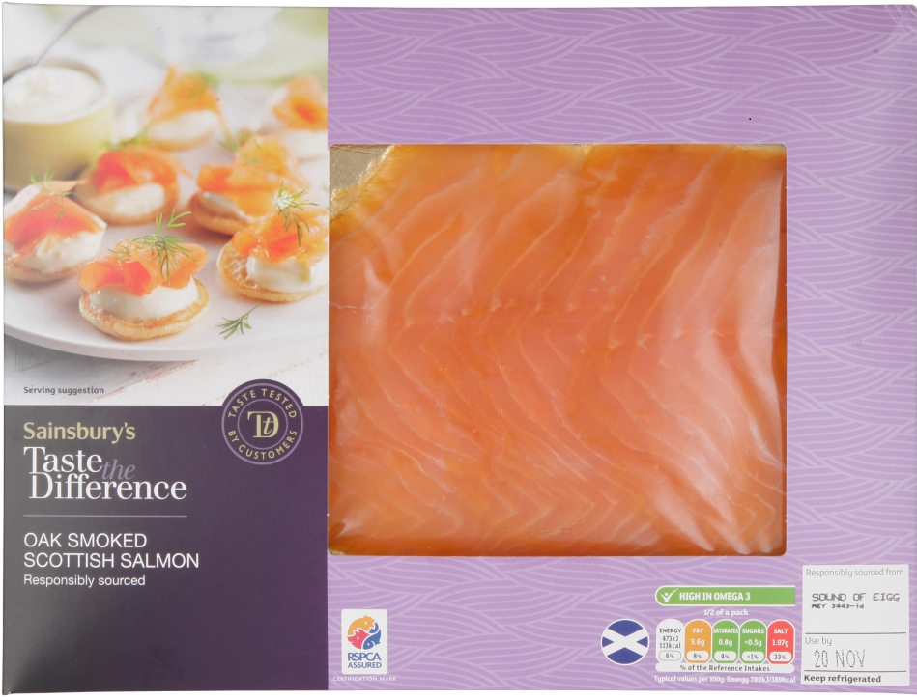
HIGH CARE – products are ready to eat but have not had a thermal process capable of killing food poisoning bacteria.
Not recommended for immune compromised people
COLD SMOKED SALMON
High/Low Care segregation is required to minimize the risk of cross - contamination during manufacture of these products
Risk if fail: food poisoning bacteria contaminate product and grow making it dangerous

Slide 5

Personal Hygiene Requirements - People
Objective
To maintain the safe status of the high risk/care areas
by having adequate control over all personnel
entering the area to minimise
microbiological cross contamination
from personnel to food products.

Slide 6
Personal Hygiene Requirements - People
General Requirements
High risk/care procedures
must be clearly posted and staff fully trained.
A clearly defined physical barrier is required
to prevent cross contamination
between low and high risk/care personnel,
their protective clothing and the changing environment.
Aspects of personal hygiene in high risk/care areas must be monitored as part of the Listeria swabbing programme e.g. hand and boot swabs.

Slide 7
Personal Hygiene Requirements - People
Facilities
Appropriate handwashing facilities
should be provided both in the
changing area and on entry to the production area.

Slide 8
Personal Hygiene Requirements - People
Protective Clothing
High risk/care footwear must be captive.
All footwear must be capable of being washed and disinfected.
The use of disposable sanitary gloves for food handling is recommended in high risk/care areas.
High risk/care protective clothing must be removed prior to leaving the department.
High risk/care protective clothing is clearly identified: light blue for production; dark green for hygiene.
High risk/care clothing should be changed at a minimum frequency of daily.

Slide 9

Environmental Hygiene Requirements – Factory
Objective
To maintain the production environment in a hygienic condition, free from environmental microbiological contaminants that may lead to product contamination with food poisoning micro-organisms.

Slide 10
Environmental Hygiene Requirements – Factory
Factory Standards
High risk/care areas must be physically segregated from low risk areas and clearly identified as high risk/care.

Slide 11
Environmental Hygiene Requirements – Factory
Equipment
Equipment must be of sound construction, hygienic design and easy to dismantle to facilitate deep cleaning.
Equipment must be limited to that essential for the high risk / care area and, where possible, captive within the area. This includes portable equipment such as product trays, pallet trucks, tool boxes, knives etc. which must be clearly identified as high risk / care equipment by the use of methods such as colour coding (yellow and white trays only for high care products).

Slide 12
Environmental Hygiene Requirements – Factory
Equipment
Routine movement of equipment e.g. product racks out of high risk/care must be controlled via a designated exit route e.g. interlock doors, rack return. Such equipment which may re-enter the high risk / care area must subsequently pass through a sterilization/sanitisation process e.g. through an oven/tray wash.
Non-routine movement of equipment out of high risk/care e.g. for repairs, must be controlled and should take place outside production hours. Prior to return to high risk/care, this equipment must be fully cleaned, disinfected, inspected and its return into high risk/care controlled.

Slide 13
Environmental Hygiene Requirements – Factory
Cleaning
Cleaning efficiency must be routinely monitored
to demonstrate a microbiologically controlled environment.
Micro swabs are taken to monitor this.

Slide 14
Environmental Hygiene Requirements – Factory
Listeria Monitoring
This is a fundamental requirement
within a high risk/care production area.

Slide 15

Materials Transfer – Getting Product and Packaging In
Objective
To ensure physical separation of potentially microbiologically contaminated materials from uncontaminated materials/finished product.

Slide 16
Materials Transfer – Getting Product and Packaging In
General
Where food materials are processed to control food poisoning bacteria and spoilage organisms,
the processing equipment must be designed in such a way that only processed food material enters
the high risk/care area.

Slide 17
Materials Transfer – Getting Product and Packaging In
Methods of Processing
Heat Treatment (e.g. cooked ingredients– zest, hot smoked, smoked salmon)
Ovens/cookers
Through ovens (batch system) with low risk loading/high risk/care exit should incorporate interlocks to prevent simultaneous opening of both sides - KILNS.

Slide 18
Materials Transfer – Getting Product, Packaging and mobile devices In
Hygienic Handling –
packaging and ready to use ingredients, e.g oil, herbs
Use of disinfectants to reduce external microbiological loading should be used:
Materials should be transferred through the spray tunnel.
Materials should either be wiped with sanitizer wipes or sprayed.
All mobile devices must be wiped with sanitizer wipes prior to entering the high care & high-risk areas
Chemical concentration and contact time are critical and must be adhered to.

Slide 19
Materials Transfer – Getting Product and Packaging In
Hygienic Handling
Materials being transferred must be deboxed / debagged / decanted as appropriate.
Double bagging may be used to facilitate this procedure.
Products which do not receive any DIRECT treatments must be supplied with certificates of analysis e.g. herbs and should be used on a positive release basis where appropriate.

Slide 20
Materials Transfer – Getting Product and Packaging In
Good Manufacturing Practice
The following additional requirements are recommended:
Rework is undesirable. Where a valid reason exists for its use a controlled system for incorporation back into the high risk / care process must be used and agreed with the Technologist.
Procedures to transfer faulty product e.g. incorrect coding, wrong packaging, back into high risk / care are required using the appropriate transfer mechanism.
Secondary outer packaging must not be allowed to enter the high risk / care area.

Slide 21


All tools must be clean & free from rust
Engineering barrier control
Tools, Equipment and mobile devices must be sanitised with spray or wipes before entering high care & high risk areas if required in the area.
All tools should be segregated per area tool boxes are in each area
NO low risk tools to be used in high care/high risk areas.
All tools must be cleaned after use to reduce the risk of allergen cross contamination between line.

