Slide 1
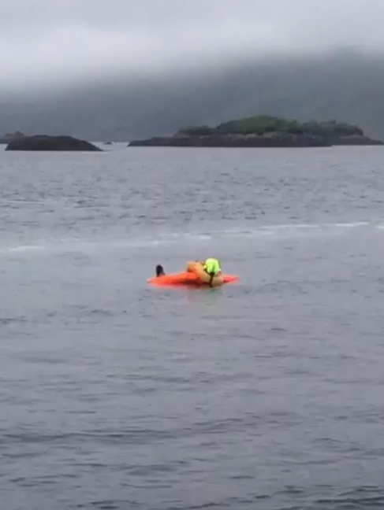
MOB Drill Guide PC vessels and workboats
August 2020
Revised September 2021

Slide 2
MOB stands for man overboard and refers to any persons who unintentionally ends up in the water from any vessel or structure.
MOWI requires all sea going staff who regularly work on vessels, barges and pens to undertake MOB drills twice annually. One of these must involve the recovery of a rescue manikin (Ruth Lee) from the water and the second can either use the rescue manikin or other floating object for retrieval.
Other staff who periodically have to travel by vessel overwater are required to complete a least one MOB drill with a rescue manikin as well as refresh their learning at a frequency determined by the company.

Slide 3
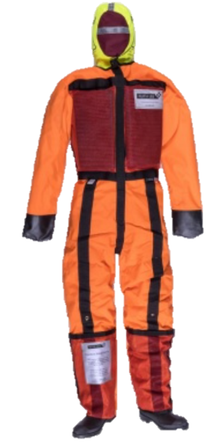
The Ruth Lee – Life size sea rescue manikins have proven to be a vital tool in achieving effective realism within the drill exercise.
It replicates an unconscious person in the water who would be unable to self-rescue.
Safe manual handling technique should be observed when handling. Ruth Lee manikin Weighs 45kg (dry weight) 65kg retrieval weight from water.

Slide 4
Why are MOB Drills with a manikin required?
Requirement under the New workboat Code
Section 13.13.1
"An efficient means to enable the recovery of an unconscious person from the water should be provided to the satisfaction of the Certifying Authority."
The benefits of practice drills
familiarisation of emergency equipment and its use
to develop your competencies and give you practice in carrying out a recue at sea
to test well-established procedures
to validate that these procedures are suitable or require refinement
To prepare you to react effectively to an emergency

Slide 5
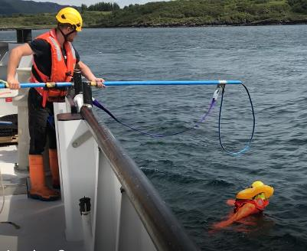
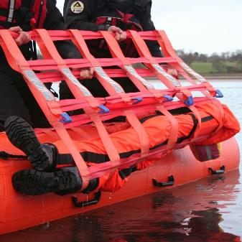
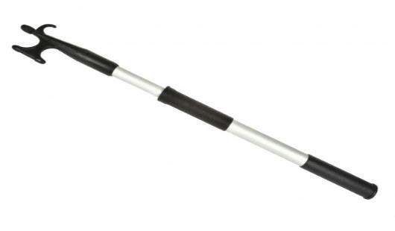
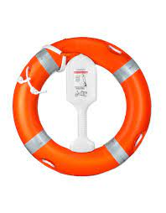
Familiarise yourselves with the types of rescue equipment and aids on your vessels
Mowi Rescue Pole
Jacobs cradle
The Ruth Lee rescue manikin can be used in conjunction with the Jacobs cradle and the Mowi Rescue Pole etc. The Mowi Rescue Pole is our preferred MOB method of recovery from workboats.
Life buoy
Boat Hook

Slide 6

New crew/staff members
Awareness and Introduction to MOB Training
All new crew/staff members must be introduced to the MOB equipment, training procedure/exercise as soon as is practicable.
Additional training exercise must be provided for new employees unless the scheduled drill/rehearsal training program is imminent.
Mowi Rescue Poles on workoats have a QR code fitted for ease of accessing the training video in Mowi Academy

Slide 7

Preparing to undertake a MOB Drill?
In advance of undertaking MOB drills consult the relevant company documentation:
Documents provided to assist and guide the MOB Drill process:
Mowi – MOB Policy
Mowi – MOB Check List Template
Mowi - Rescue pole video, SOP, Risk assessment (if being used)
i-Auditor MOB Record template
Risk Assess:
Dynamically risk assess the area for additional for hazards prior to undertaking any emeregenecy drill
Check the weather and tidal conditions

Slide 8
Drills/ Exercises:
Each region has access to the (Ruth Lee) training manikin.
Drills/training with the Ruth Lee Manikin prevents the need for crew/staff member from getting in the water and possibly getting injured, whilst still simulating a realistic event.
Drills – to take place twice a year in an “underway” scenario, ensuring crew/staff are familiar with open water and getting the boat to the casualty.
The drills should include a pre-safety meeting, review of the policy, procedures or videos. Crews/staff are encouraged to video their MOB drills so they can see how they are doing.
Photos of the drill exercise can be uploaded into i-Auditor MOB Record as evidence.
Every crew/staff member should take a turn with each part of the rescue, for familiarity. They should talk about it after and log/record it accordingly.
When the drill is completed the MOB manikin should be cleaned in fresh water, disinfected, before transfer to other sites. Other sites must be informed that the manikin is available

Slide 9
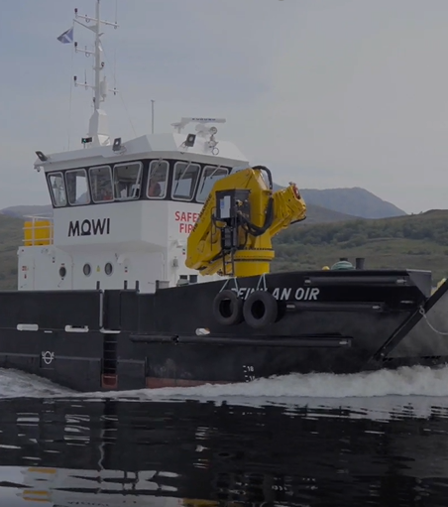
MOWI - MOB Rescue Pole Drills - Workboats

Slide 10
Man Overboard Drills from Workboats Video
Please view the video in the portal

Slide 11
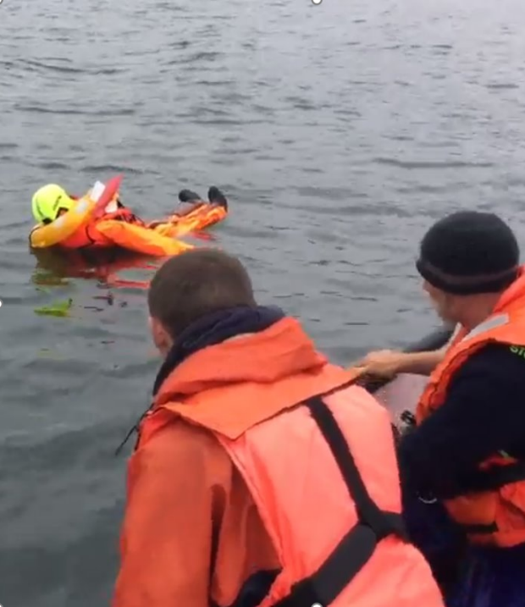
MOWI - MOB Rescue from PCs

Slide 12
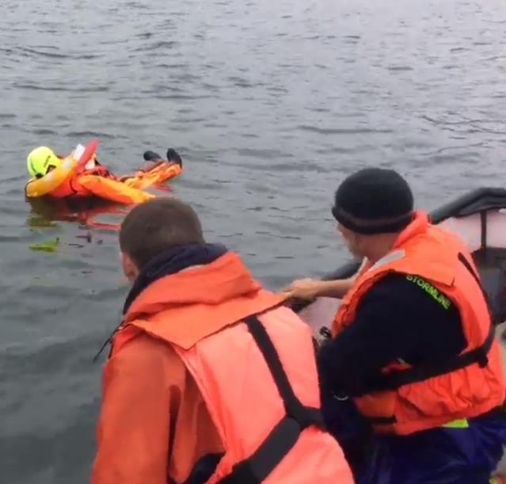
Man Overboard from a RIB
Techniques for man overboard recovery for Powerboats and RIBs –without rescue poles
If someone goes overboard:
Alert the crew by shouting 'Man overboard’ three times
Keep visual contact on the MOB all times. If there is more than one person left on the RIB instruct them to point to the MOB at all times.
At slow speed turn the wheel towards the MOB. This moves the prop away from the MOB.
Effect a slow controlled manvourve back towards the MOB.
In a real life scenario make a DSC distress alert and Mayday call

Slide 13
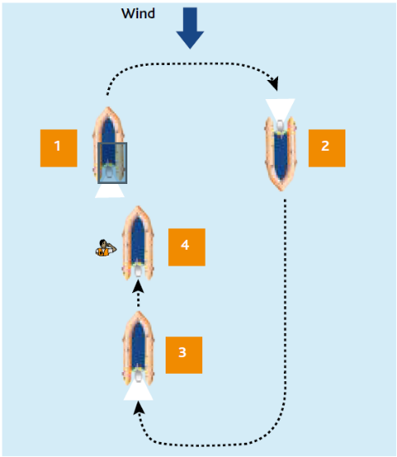
PC and RIB boat MOB manouver: Method 1
Method 1 – Into the wind
Reduce speed gradually and assess the conditions.
Position the vessel six boat lengths downwind/down sea of the MOB.
Approach the MOB at minimum speed. Brief the rescuers which side you intend to recover the MOB.
Once you have reached the MOB, if conditions allow and it is safe to do so, switch off the engine and recover them.

Slide 14
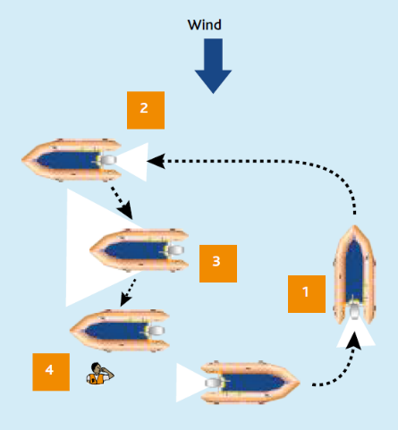
PC and RIB boat MOB manouver: Method 2
Method 2 - Drift down approach
Reduce speed gradually and assess the conditions.
Position the vessel beam to the wind, upwind of the MOB.
While drifting down to the MOB, maintain the vessel’s line using small amounts of forward and reverse gear. Position the crew ready to recover the MOB.
Once the vessel is in this position, contact can be made with the MOB and recovery can take place. If conditions allow, and it is safe to do so, switch off the engine.

Slide 15
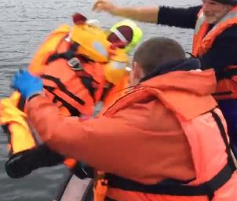
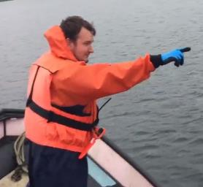
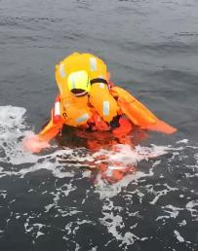

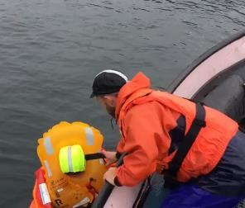
1. Deploy the training manikin, shout man overboard three times
2. Where possible a spotter points to and
keeps an eye on the casualty
3. Simulate a distress call
Vessel carefully manoeuvres into position
4. Once vessel positioned get a hold of causaulity to stop them drifting

Slide 16
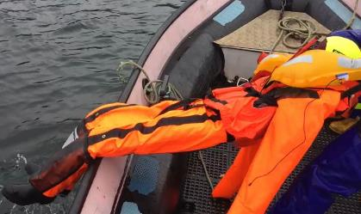
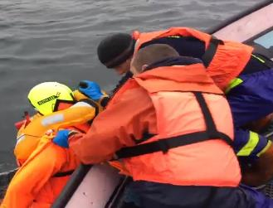
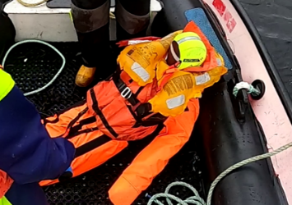
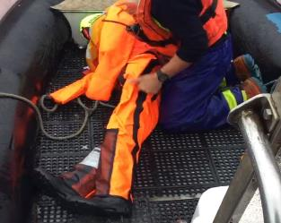
5 One-person rescue: Haul causauly from their rear onto the vessel, being aware of their back and yours.
6. Whenever possible carryout a two-person lift, being aware of their back and yours.
7. Once safely onboard put casualty into the recovery position

Slide 17
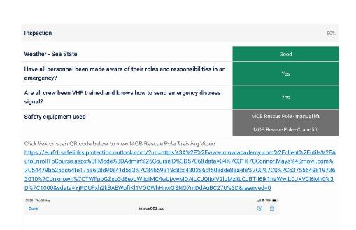
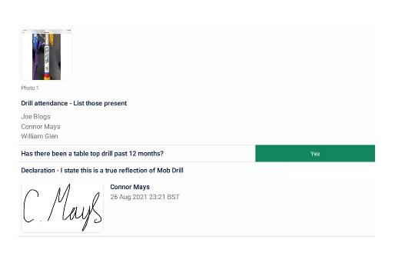
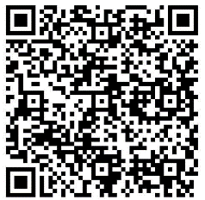
i-Auditor Drill exercise records
Managers and skippers are to enter the record of the MOB drill into I-auditor
Digitised record systems provide a log of those undertaking drill exercises – where, when, vessel & equipment used etc
QR Codes offer digital links to system operations, via mobile apps, phone etc.,

Slide 18
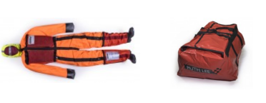
Disinfection of Rescue Manikin
Disinfection prior to transfer between sites
As with the movement of all equipment between sites/locations the equipment must have a movement request.
Movement request documents to be completed and submitted.
To speed up the movement process you can contact the Fish Health manager who on confirmation of disinfection can authorise the movement of the equipment with immediate effect.
Disinfection process
Manikin weighs 45kg (dry weight) – two man lift for moving
Rinse manikin with fresh water and remove any debris
Clean/wash with Aqua Clean
Disinfect with Virkon, this can be sprayed on – ensuring the entire surface is wetted with a min exposure 15 minutes
On confirmation from your Fish Health manager the equipment can be transferred to the next site/location

Slide 19
Thank you for your attention

