Slide 1

Non GM Module – GlobalGAP
Mowi Scotland Ltd –
Broodstock and Feed

Slide 2
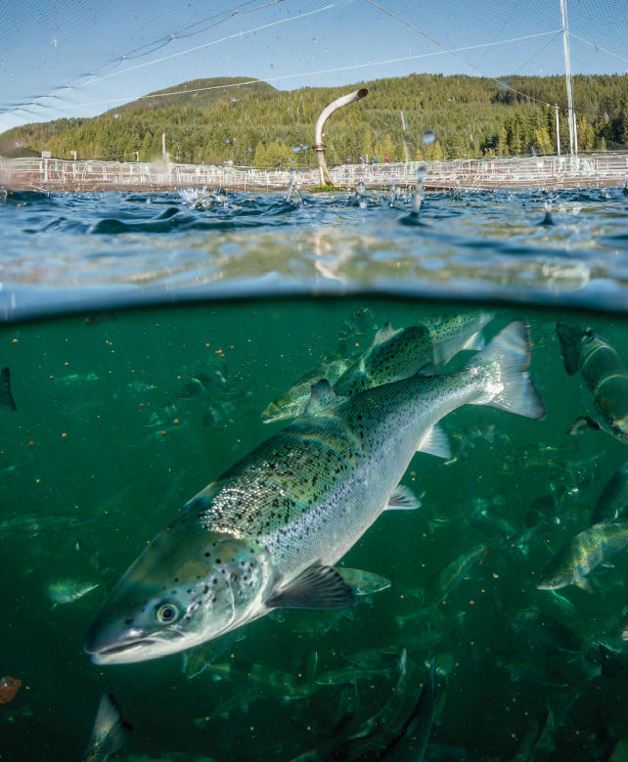
Contents
Background:
GM organisms- what is it ?
Why non GM certification?

Slide 3
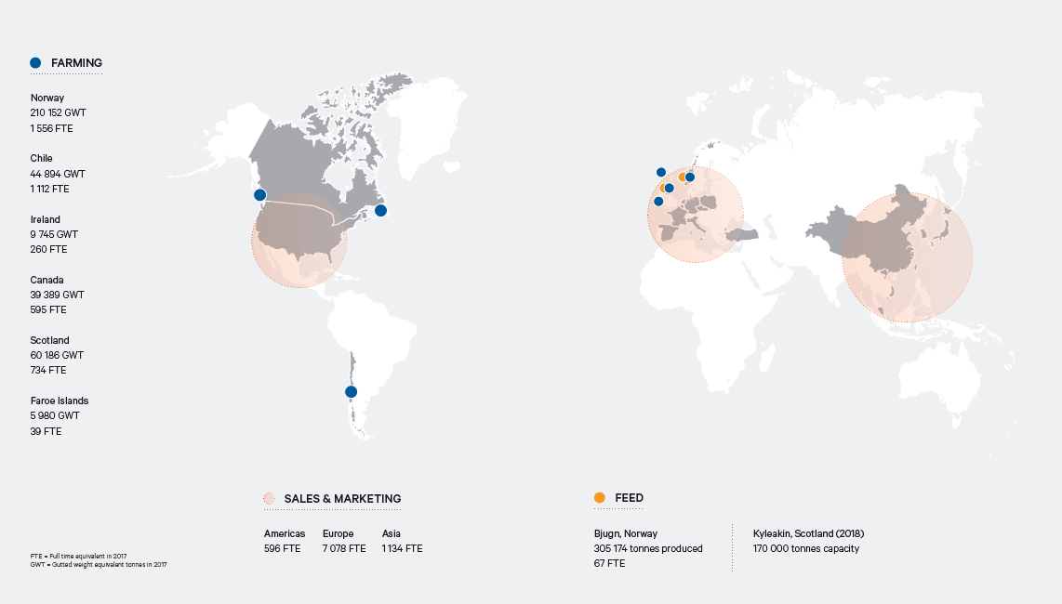
Mowi
Represented in 24 countries, offer Mowi products to 70 countries around the world.
Notes:
We are organized into three Business Areas:
Feed:
Feed plant, located in Norway.
A new feed plant will be opened in Scotland, in 2018.
Farming:
Farming operations, some primary processing and filleting activities, in Norway, Scotland, Canada, Chile, Ireland and the Faroe Islands.
Sales and Marketing:
Secondary processing and value added operations in Europe, US and Asia, and sales, logistics and delivery of our products obtained from our farming operations.

Slide 4
Non GM
For GlobalGAP Non GM Certification, both them feed and the stock (ie from ova stage) must be Non GM. Statements (or appropriate certification) attesting to this are available from Qualiuty Systems Dept

Slide 5
What is GMO?
GMO means genetically modified organism:
Organisms where the genes have been artificially modified to give them a new desired trait.
Genetic modification includes mutation, insertion or deletion of genes.
An example of where genetic modification is most used:
To provide resistance to plants against special diseases, insects, and/or boost their productivity.
The use of GMO is still controversial, and the EU has very strict rules around approving the production, commercialization and use of genetically modified organisms.

Slide 6
Todays status for GM feed for fish is:
All fish farmed Salmon in Europe are fed on non-GMO feed.
Mowi Scotland produces only GM free feed and is currently awaiting certification from GlobalGAP.
Canada and Chile produce MOWI fish which are fed feed containing some genetically modified ingredients. This is standard practice in these two countries, but Chile also produce non GM feed for European retailers.

Slide 7
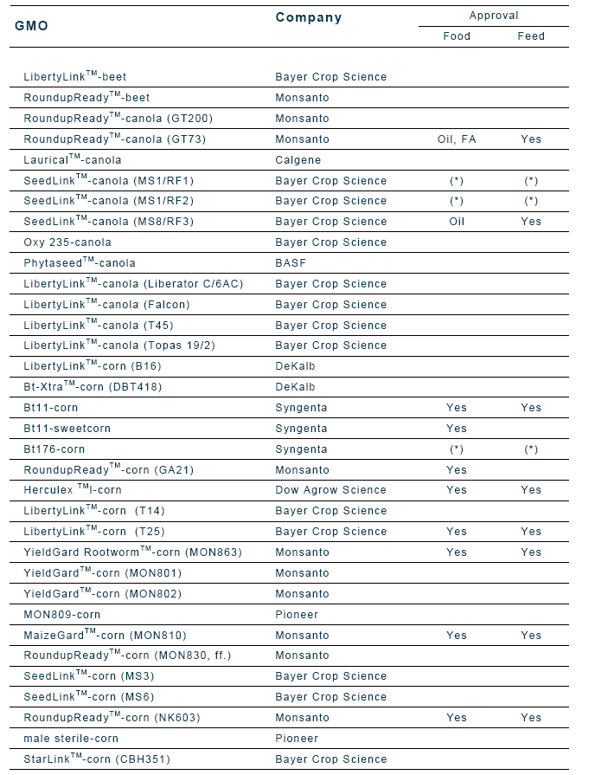
GM-regulation
Example on approved GM:
EU regulations:
  Only EU approved GM products are allowed.
  There is zero tolerance for GM products which are not approved by EU .
    Status for Scoland and Norway – no GM products are approved for food or animal food (pork, poultry, aquaculture, milk , cattle etc).
  GM-labeling: All food or feed wich is GM, or contains GMO ingredients much be labelled as such
  To be certified as GM free:
  Producers must prove that the product is GM free. They must also be able to track that all the raw materials (eg feed) and/ or the product itself is GM free. This must be proved by lab analysis, - max level of GM components identified is 0.9% of eh final product.
  The level of 0.9 % is set because for various reasons it is technically impossible to prove 0% due to the analysis uncertainty and traces of some GM material can often occur.
  Fish fed with GM feed, is not certfied as being Non GM. All Mowi ova are non GM
Notes:
The GM-products that previously was not approved where 0,5% limit applied have now been approved by EU.

Slide 8
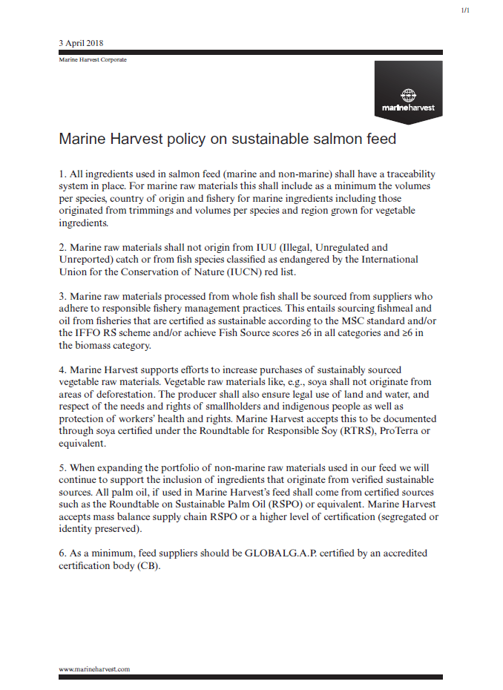
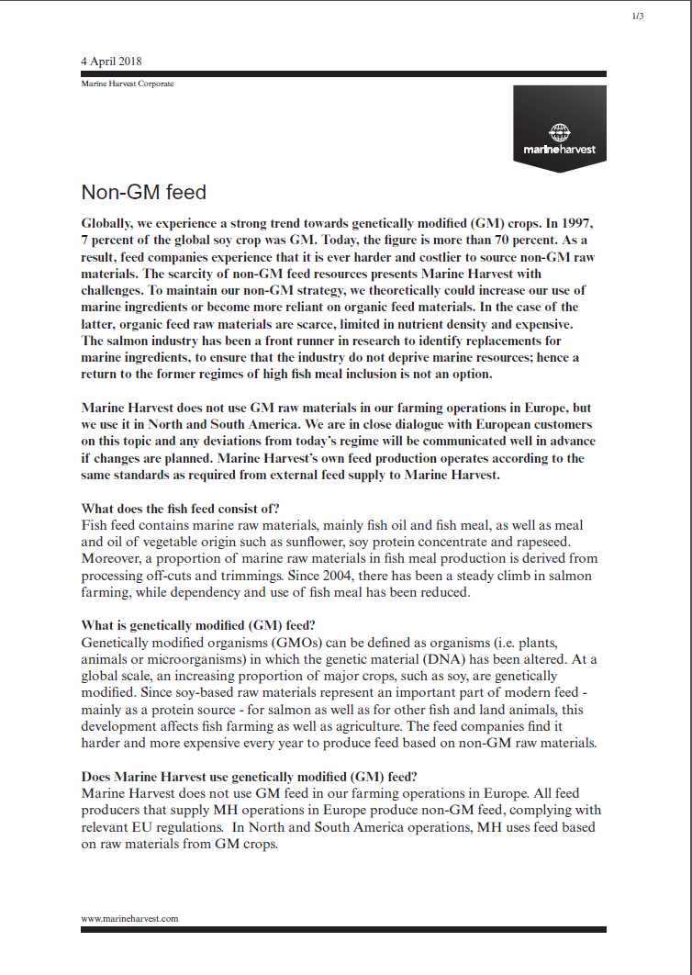
Mowi GM policy
Mowi is not totally against GM ingredients in its feed.
Our salmon in Canada and Chile are fed feed containing some genetically modified raw materials - the most common genetically modified raw material is soy.
GM free production in Europe on fish feed will maybe change in the future.
Mowi Scotland feed is non GM. We would only start producing GM feed after agreement has been reached with our customers.
Global % GM soy production 1997-2017:
1997
7%
2017
>70%

Slide 9
What does Non GM certification mean for you as a manager and staff member?
The Non GM module is an addition to the GlobalGAP standard and all Mowi Scotland sites have GlobalGAP certification and can therefore be certified to the Non GM module.
The same principles apply to this additional module as with the rest of the GlobalGap Standard : In order to be able to supply GlobalGap certified fish, the broodstock (ova), seawater fish and feed must also be GlobalGap accredited.
will be no specific changes in your daily work as Mowi Scotland only produce fish that have eaten non GM feed and thus do not need specific systems to differentiate between non GM and GM goods / fish. All ova purchased for Mowi sites are also non GM
However, it is important that you are aware that as we now embark on this certification, all feed and stock delivered to your site must be GlobalGAP.
If Mowi Scotland ever needed to buy external (non Mowi Scotland) smolts or Ova, it is very important that production management be made aware of this and that any consequences that this will cause will be considered.

Slide 10
Thank you

