Slide 1
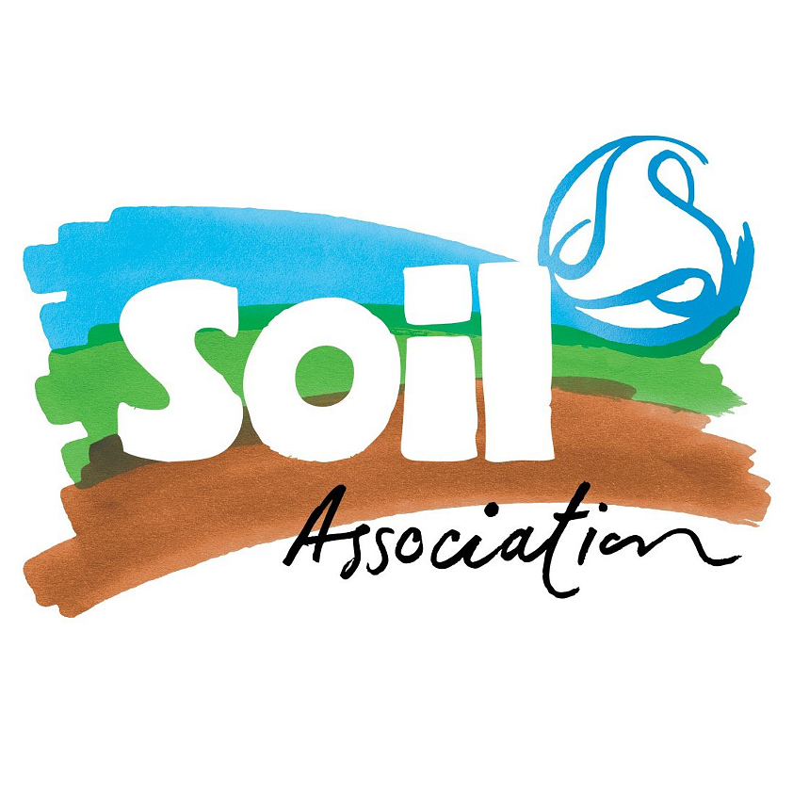
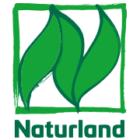
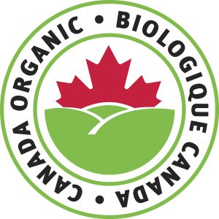
Organic Fish Feed
Kyleakin mill
November 2022
Quality & Food Safety team

Slide 2
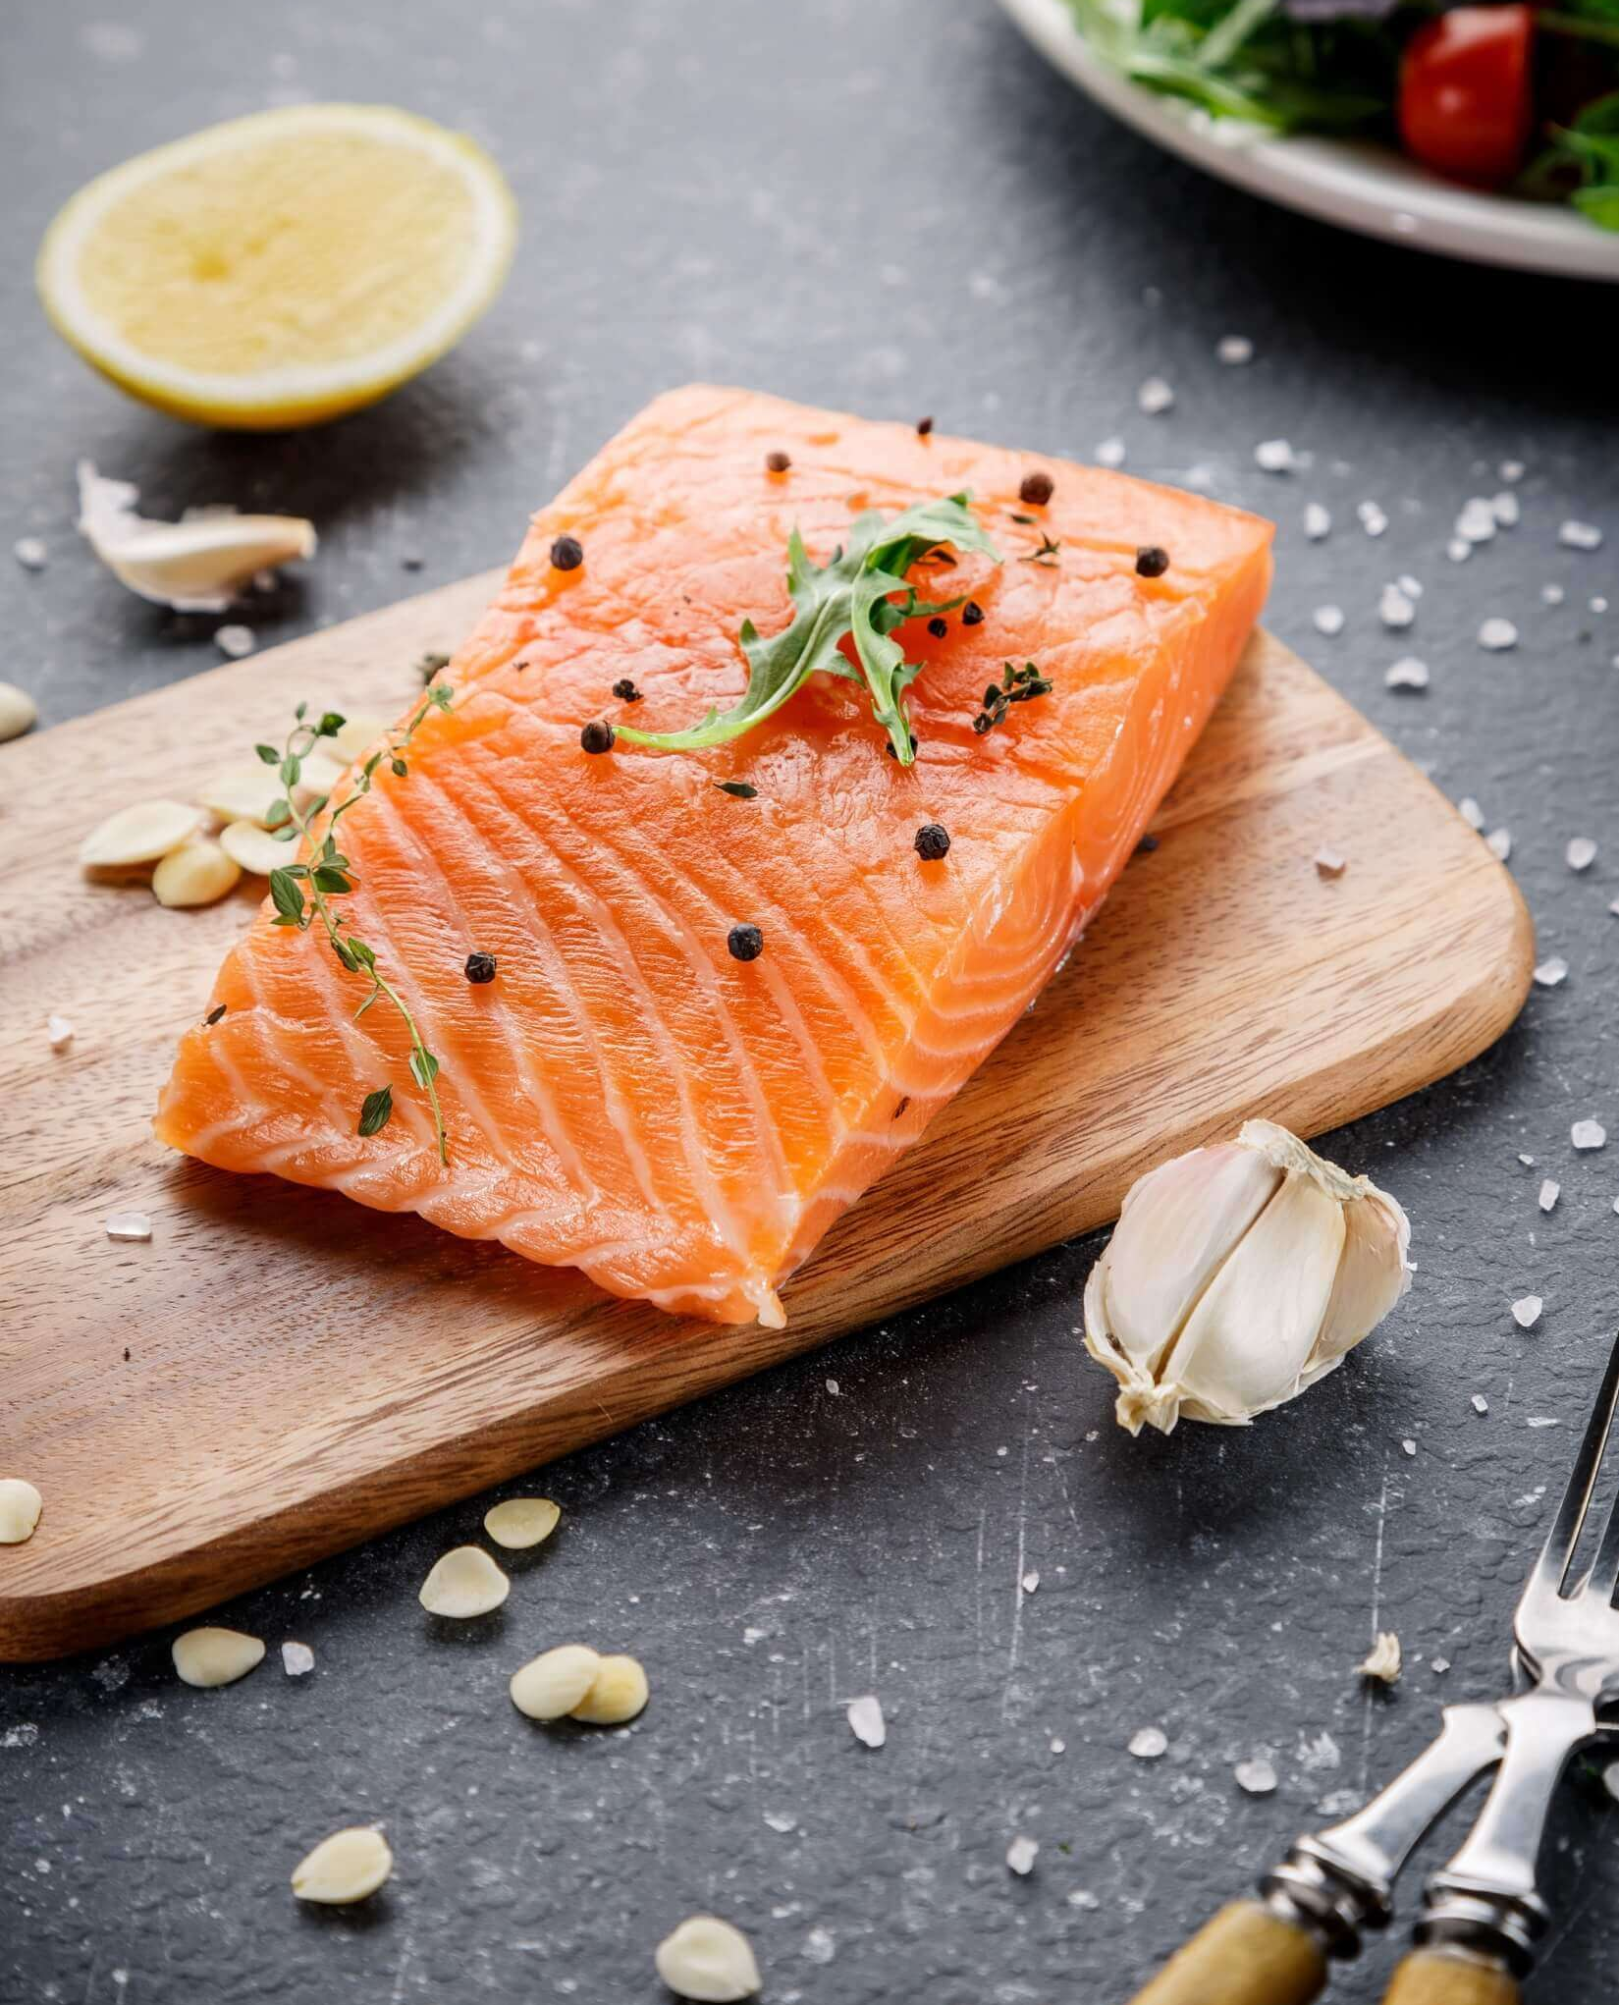
Update
In this update training we remind ourselves what organic fish feed is all about and how it differs from all the other feeds we produce. We’ll refresh on the key elements of the manufacture and distribution of organic feed. And update on recent changes to regulations and standards that we must comply with.

Slide 3
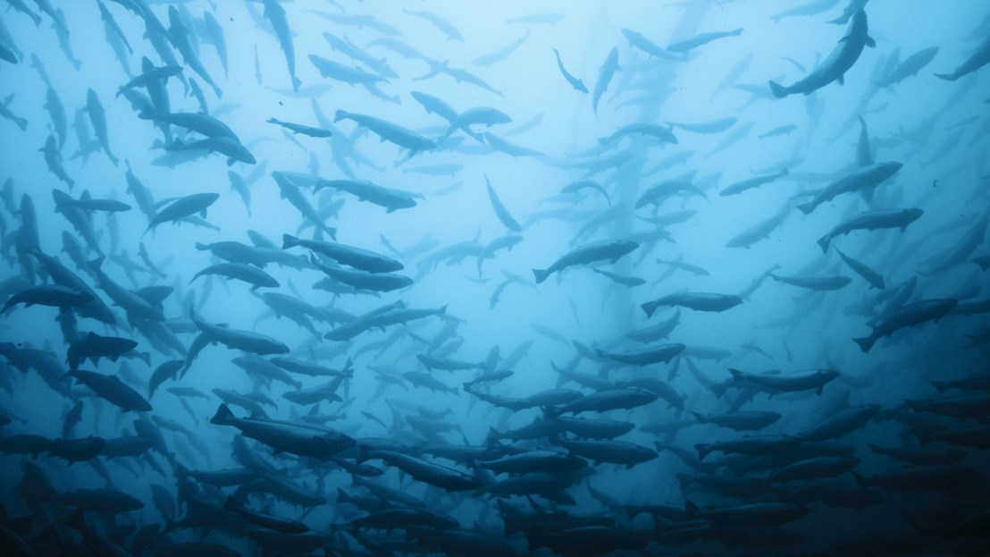
First, a reminder - What is ‘organic’?
Organic farming is an agricultural method that aims to produce food using natural substances and processes. This means that organic farming tends to have a limited environmental impact as it encourages:
the responsible use of energy and natural resources,
the maintenance of biodiversity,
preservation of regional ecological balances,
enhancement of soil fertility,
maintenance of water quality.
Additionally, organic farming rules encourage a high standard of animal welfare and require farmers to meet the specific behavioural needs of animals.
Production of organic food is an end-to-end process: farming, feed manufacture, food processing, storage & shipment, all stages must meet organic requirements & be certified.

Slide 4

What is new in the world of ‘organic’?
Since we started producing organic feed back in October 2019 the UK has left the European Union (BREXIT) and this has brought about a lot of change and additional work for us:
Despite being outside the EU we must continue to follow EU Organic Production Regulations (but now have no influence on their evolution or requirements).
There is new GB organic requirements & regulations.
Organic labels have been changed to include new information required to export feed to Ireland.
The third-party external feed store at Foyle Port in Northern Ireland has gained organic approval and operates under our certifications.
and there are others, but they’re not that interesting!

Slide 5
There’s more new stuff …..
We continue to be audited by and certified to Soil Association and Naturland Standards, and recently passed our first audit against the Canadian national organic Standards (known as ‘COR’, Canadian Organic Regime). In the Standards we see a couple of big changes and new requirements we must meet;
Firstly, there’s increasing focus on Sustainability and Responsible Sourcing of raw materials. New requirements are set around compliance with internationally established sustainability standards, especially toward fishmeal, fish oil and soya.
Secondly, new and expanded requirements around Social Responsibility toward the people who work in the organic production supply chains. These include requirements around human rights, discrimination, employment conditions, collective bargaining, wages, work hours and social benefits.

Slide 6
What is organic feed?
Producing organically means respecting the rules and regulations governing all areas of organic production. These are based on a number of key principles, such as:
prohibition of the use of GMOs,
no use of industrial solvents or ionising radiation,
no synthetic additives, such synthetic pigments & synthetic amino acids,
prohibiting the use of hormones and restricting the use of antibiotics to only when necessary for animal health,
no use of nanomaterials, for example in packaging.
Throughout the organic production, respect of organic integrity is paramount and great care must be taken to prevent contamination by conventional (none organic) products and prohibited substances.

Slide 7
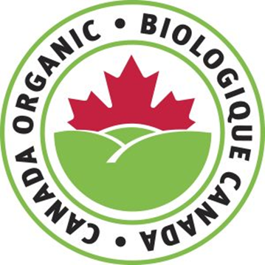
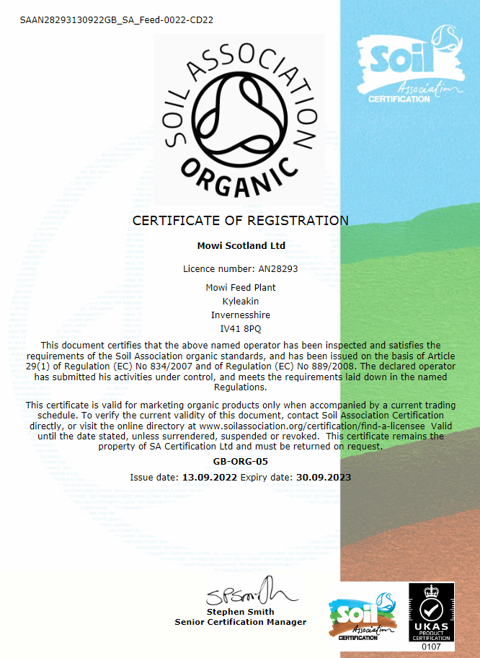
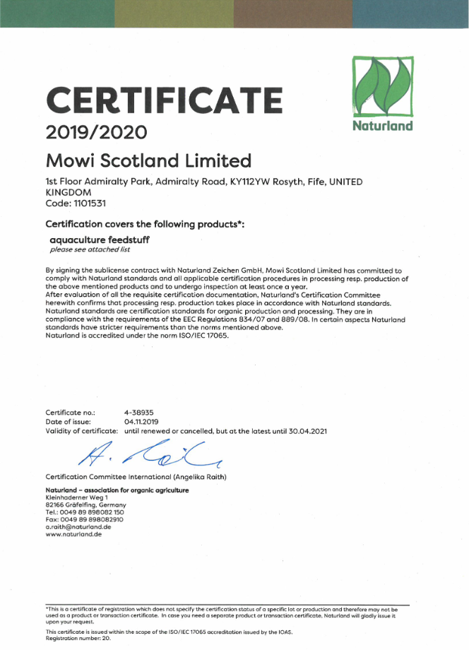
Mowi Feed Kyleakin’s Organic Certifications
Since starting organic feed production back in October 2019 we have maintained the organic certifications requested by our customers >> Soil Association, Naturland and recently, COR.
This means we must continue to follow all the rules of the EU organic regulations, along with the requirements of the Soil Association, Naturland and COR Standards. These we have transferred to our Organic Procedures.
To check we are keeping to the rules, we are inspected (audited) annually by Soil Association’s Certification Body. They are an EU approved, independent, Certification Body who certifies our processes and the organic feeds produced (they inspect all three of our standards).
Without these certifications, we can’t supply organic feed.

Slide 8
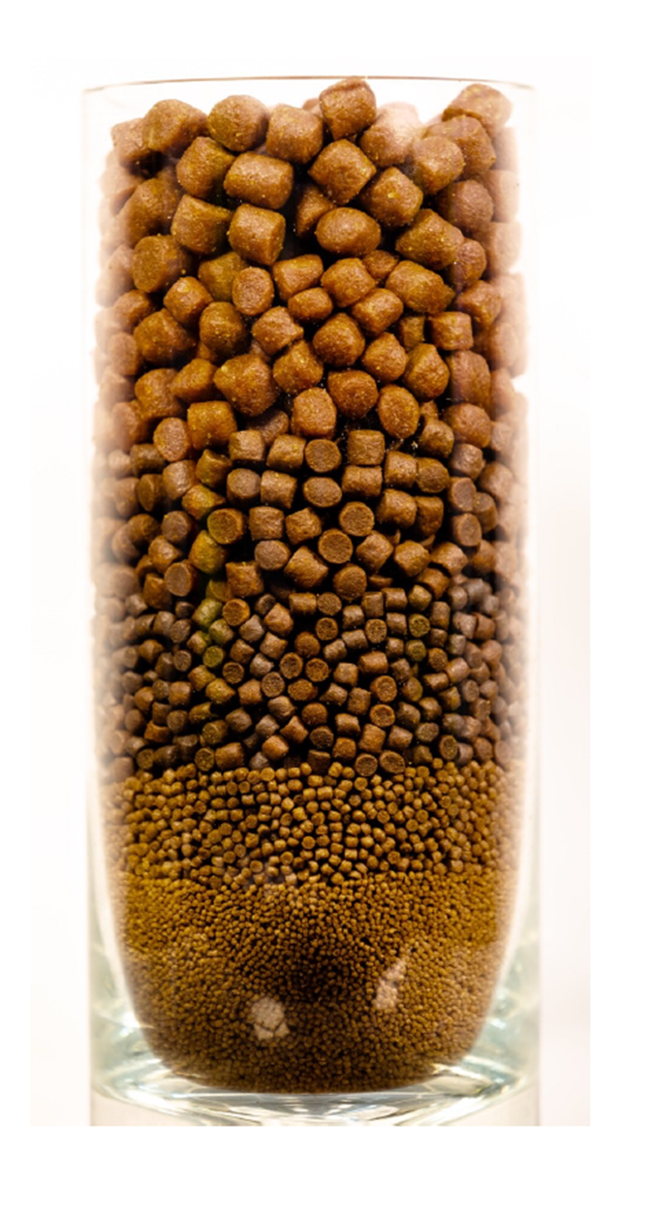
Our organic feeds
We are approved to produce the following organic feed ranges:
RHEA in sizes 2, 10, 25, 50 & 200 for feeding in freshwater.
GAIA in sizes 50, 200, 600, 1200, 2500 & 4000,
GAIA 1200 HH, (HH = ‘high histidine’ for cataract prevention)
GAIA AF in sizes 600, 1200, 2500 & 4000,
Aceso in sizes S, M & L and Aceso L HH,
all of which are for feeding in seawater.
The high fishmeal inclusion of the organic feeds(40% to 70%), coupled with a lack of availability of organic VWG, SPC or CGM, and the need to ensure production of a firm, durable pellet, means that these feeds need manufacturing & testing in a very specific way that’s quite difference to standard, non-organic feed.

Slide 9
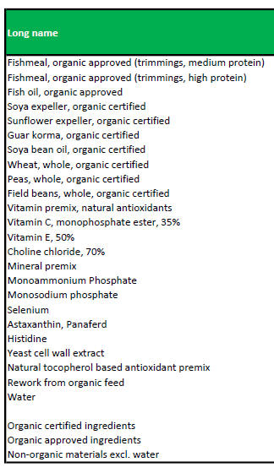
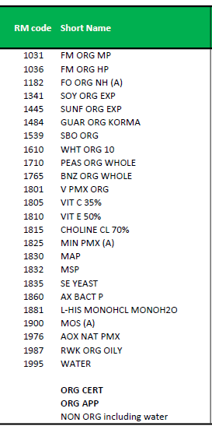
Our organic raw materials
Sourcing organic raw materials is a challenge due to their limited availability, difficult supply chains and the need to meet specific Naturland requirements
Currently we only have 4 suppliers of certified organic fishmeal/oil and 4 suppliers of certified organic vegetable products (wheat, beans, peas, soya oil & meal, sunflower meal and guar korma meal). All the other raw materials are not organic certified but under EU organic regulations are accepted for use to ensure a nutritionally complete feed.

Slide 10
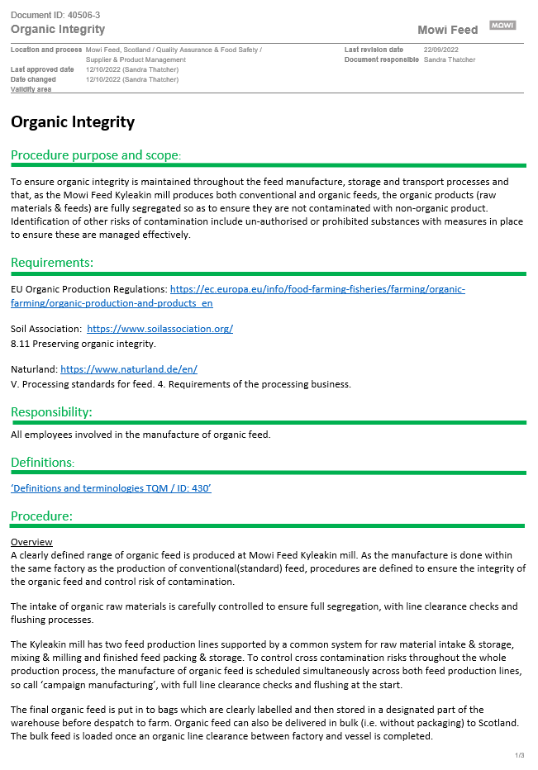
Our organic feed manufacturing procedures
Segregation and Traceability. All organic raw materials and feeds must be kept separate from non-organic raw materials and feeds to minimise any risk of cross contamination (of non-organic in organic).
To do this we have standard operating procedures (TQM SOPs) to ensure:
Checks of all incoming raw material to be absolutely sure we know which are organic.
Dedicated storage of organic raw materials and organic feeds = specific silos, bins, tanks & warehouse areas.
Before moving organic materials & producing organic feed, all lines must be flushed, equipment emptied and inspected as clear of contamination.
Green feed bag labels to clearly indicate organic feed within.
Detailed, complete records to control & evidence what we have done when producing our organic feeds.

Slide 11
Organic feed storage & distribution
Segregation and Identification must be carefully maintained throughout the storage and distribution of organic feed.
Having the feed in sealed bags helps to prevent the risk of contamination by non-organic feed. And the green ‘organic’ labels aid identification. Clear organic identification is important to both us and the farmer, particularly where there is organic and non-organic in the same storage facility.
In warehouses and external stores organic feed bags must be kept physically separate from non-organic bags. This means allowing a gap between organic bags and non-organic bags to reduce the risk of mixing up bags by mistake.
When organic feed is out-loaded in bulk to the Mikal With, procedures must be followed to ensure lines between the factory & vessel, and vessel & farm, are all run-empty and so clear of any non-organic feed. Clear segregation and complete records must be maintained by the feed vessel.

Slide 12
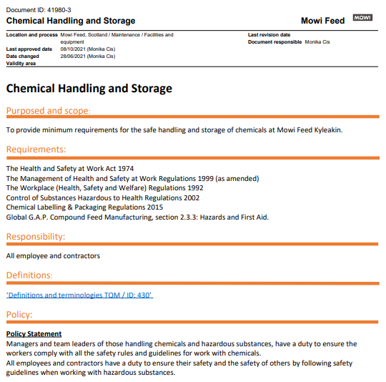
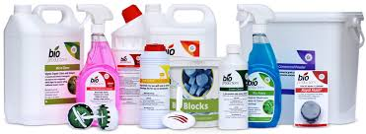
A reminder about chemicals
The Regulations and Standards are explicit about the chemicals we can use in & around our organic mill and also on our feed boats. This covers cleaning products (agents), pest control compounds, process aids etc and includes any chemicals bought on site for use by contractors.
If you are unsure about the suitability of a chemical or are considering purchasing a new chemical, please be sure to check first with QA.

Slide 13
Lastly, always worth remembering.
So far, over our first three years of organic production things have gone well. Our organic feed production & supply procedures are bedded in. The fish have grow well, although there have been a few pellet physical quality challenges. However, be clear that there will be very serious consequences for Mowi if we get it wrong and organic fish are fed feed that does not comply with organic rules and regulations.
If this were to happen the affected fish would loose their organic status and be downgraded to conventional salmon. This would cause significant financial loss to Mowi and be extremely detrimental to our organic faming operations.
In addition, considerable reputational damage would be done to Mowi as our failing ripples through the industry and beyond.
So please keep up the good work. Follow procedures and complete records as they are there to help ensure, and evidence, that the correct processes are being done.

Slide 14
If you have any questions about Organic, please ask the QA team Do not guess or assume, ask so we continue to get it right!
Thank you.

